Slide 1
Bolton CVS Membership

Slide 2

Membership at Bolton CVS
Membership is free of charge and simple to apply.
We have two levels of membership:
Steps to becoming a member:
Submit an application online
Read and accept the Bolton CVS membership agreement
Attend a membership meeting (phone/Teams/in person)
Your application is submitted to our board of trustees for approval
FULL MEMBERSHIP is open to any constituted voluntary and community group or organisation based in and operating within the Borough of Bolton which is sympathetic to our mission and values.
ASSOCIATE MEMBERSHIP is open to organisations and individuals who are sympathetic to our purpose and values but who do not qualify for our full membership.

Slide 3

Membership Benefits
Attend and vote at the Bolton CVS AGM
Open4Community Funding Portal access
Training and events
Rent a mailbox at The Bolton Hub
Discounted rates on meeting rooms at The Bolton Hub
Opportunity to be involved in different projects, research and collaborative opportunities with partners
Discounted rates on bespoke training sessions
Funding Update WhatsApp group access
Membership Portal access

Slide 4
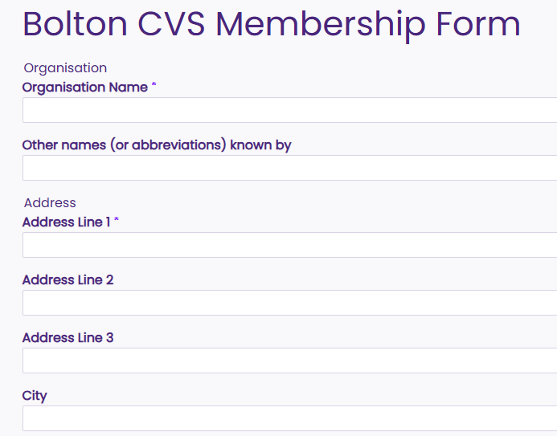
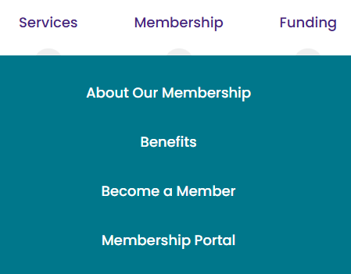
The Bolton CVS Membership Form

Slide 5

Let’s Welcome Our Newest Members:
Potora Empowered Journey CIC
Sisterhood Champions
The Parenting Collective CIC
The Vegan Society

Slide 6
Training Update
We offer a range of specialist training courses designed to develop the skills and knowledge of the diverse Voluntary and Community Sector in Bolton. All our sessions are tailored in line with what you tell us you need and are designed to be accessible to all levels of staff and volunteers. Go to our Training and Events webpage to see the full list.
Benefits of Volunteering Workshop
24th September 10:00am - 11:00am
The Bolton Hub
Thinking of working with others? An Introduction to Partnership Working
30th September 10:30am - 12:00pm
The Bolton Hub
Information Governance and General Data Protection Regulation
15th October 10:00am - 12:00pm
The Bolton Hub
Safeguarding in the VCSE Sector
21st October 1:00pm - 3:00pm
The Bolton Hub

Slide 7


