Slide 1
Bolton CVS Membership

Slide 2

Membership at Bolton CVS
Membership is free of charge and simple to apply.
We have two levels of membership:
Steps to becoming a member:
Submit an application online
Read and accept the Bolton CVS membership agreement
Attend a membership meeting (phone/Teams/in person)
Your application is submitted to our board of trustees for approval
FULL MEMBERSHIP is open to any constituted voluntary and community group or organisation based in and operating within the Borough of Bolton which is sympathetic to our mission and values.
ASSOCIATE MEMBERSHIP is open to organisations and individuals who are sympathetic to our purpose and values but who do not qualify for our full membership.

Slide 3

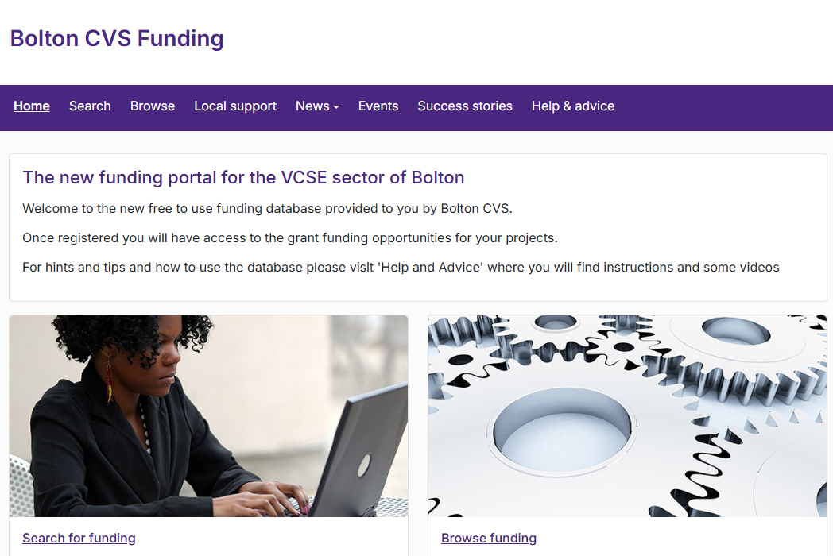
Membership Benefits
Access to the Open4Community Funding Portal
Development support
Access to training and events
Opportunity to be involved in different projects, research and collaborative opportunities with partners
Invitation to different spaces
Vote at the Bolton CVS Annual General Meeting (AGM)
Members’ online portal

Slide 4

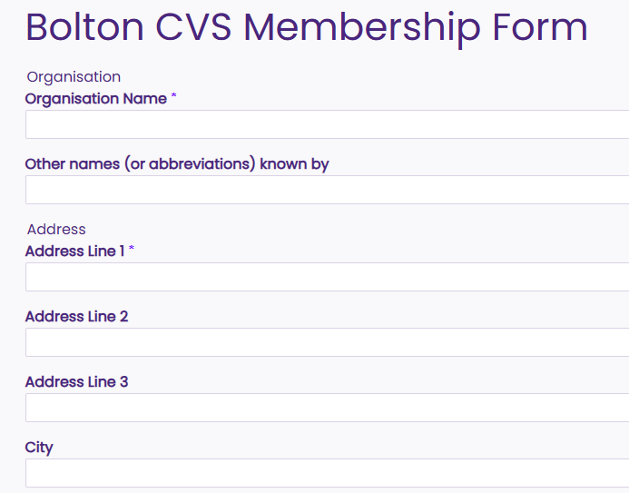
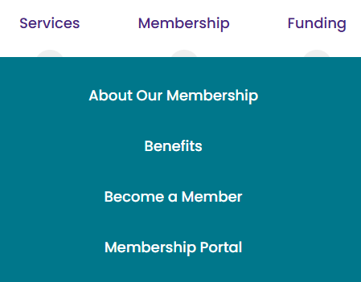
The Bolton CVS Membership Form

Slide 5

Let’s Welcome Our Newest Members:
Bolton Neighbourhood Watch
Breathchamps CIC
Can-Survive UK
Densal Global CIC
Directions For Men CIC
Making Space
Migrant Haven
Revive CIO
Scope
Shekinah Music Ministry
The Antioch Network: Oldham’s Church
The Co-op Group
Time to Help UK
Women Together

Slide 6
