Slide 1


Funding Update – July 2025

Slide 2

Funding Team Update:
Non CVS Funding (not distributed by Bolton CVS)
Funding – Whatsapp Group
What is Bolton’s Fund?
Bolton Community Homes grants
How to apply for grants
Open 4 Communities
Finding Funding
Membership
Contact: funding@boltoncvs.org.uk

Slide 3

Non-CVS Funding - The Development Team
Support for funding not administered by Bolton CVS (external funding) will be provided within the Development Team.
This will include:
Supporting groups to be ready for funding.
Accessing Open4Community for member organisations.
Identifying funders for non-members.
Checking bids and offering tips on how to strengthen applications. Bid writing is not included.
For the sector, the support can be requested either by emailing info@boltoncvs.org.uk or by calling 01204 546010.
Contact: funding@boltoncvs.org.uk

Slide 4


Bolton CVS Launches Members-Only WhatsApp Group for Funding Updates
Bolton CVS is pleased to announce the launch of a new members organization only WhatsApp group chat dedicated to providing timely and relevant funding updates.
The WhatsApp group will serve as a quick and accessible way for members to stay informed and connected. Please note:
The group is strictly for Bolton CVS members .
It will be used for broadcasting funding-related information only – no open discussions or promotional content.
Members will receive concise, targeted updates to support funding bids and strategic planning.
Having an account on our website doesn’t mean you are a member organization.
If you need to check if you are a member organization, please contact info@boltoncvs.org.uk
If you are a member organisation and would like to sign up to the Whatsapp group, please contact funding@boltoncvs.org.uk and we will send you the link to the sign up page.
Contact: funding@boltoncvs.org.uk

Slide 5
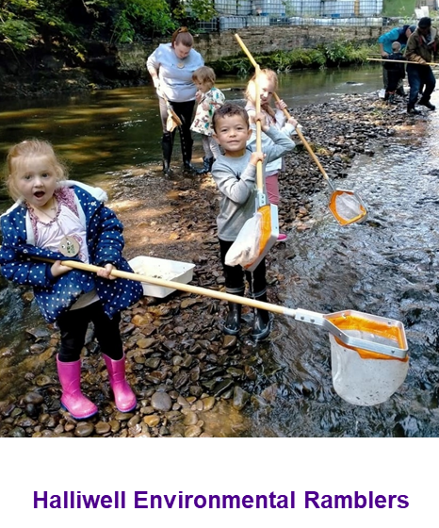
What is Bolton’s Fund?
Bolton’s Fund is a grants programme.
Short term funding (maximum 12 months).
Supports delivery of projects and activities.
It benefits people and communities across the Metropolitan Borough of Bolton.
It exists to support the VCSE sector in Bolton to grow and thrive.
Bolton CVS are contracted by Bolton Council to administer Bolton’s Fund and provide support for groups across all stages of the application process.
Notes:
Definition of a grant:
Grants are a specific amount of funding given to an organisation for specific activity to be delivered within a specific time frame.

Slide 6
Bolton’s Fund - Eligibility for Grant Levels
Name of Grant | Max size of grant | Eligibility (based on income level) | Size of group eligible*
Micro | £2,000 | Less than £100,000 per year | Micro and Small
Small | £5,000 | Over £10,000 and under £1m | Small and Medium
Medium | £15,000 | Over £100,000 per year | Medium and Large
Partnership | £35,000 | Lead organisation to show they have experience of delivering similar sized grant funded projects. | All sizes
*Income Level of groups
Micro - income under £10k per year Small - income between £10k and up to £100k per year
Medium – income between £100k and up to £1m per year Large – income over £1m per year

Slide 7
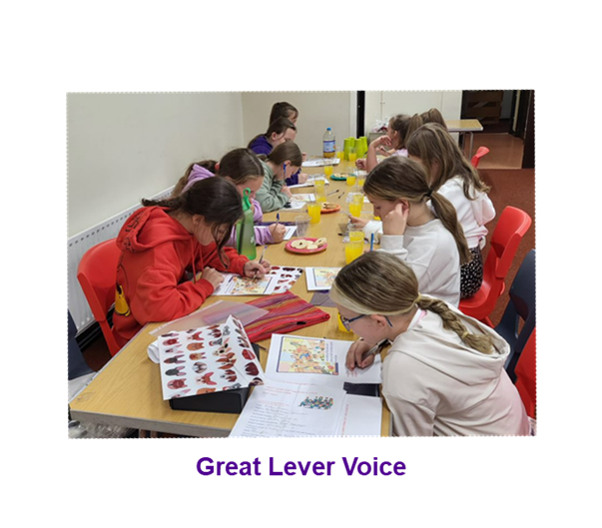
Assessment Questions
Across Micro, Small and Medium
Do you think the project is well planned?
Does the application explain the need for the project?
How confident are you that the proposed project will have a positive impact on the lives of Bolton residents?
Does the proposed project demonstrate value for money?
Additional for Medium Grants
How well will the proposed project achieve the priorities of the fund?
Does the proposed project have any additional environmental, economic or social benefits for Bolton?
Every question is scored from 0 – 5

Slide 8
Assessment Questions – Partnership Grants
How confident are you that the lead partner has the experience and track record of delivering successful projects?
Do you think the partnership project is well planned?
How confident are you that the named partners will bring added benefit to the project and the beneficiaries?
Does the application explain the need for the project?
How confident are you that the proposed partnership project will have a positive impact on the lives of Bolton residents?
How well will the proposed project achieve the priorities of the fund?
Does the proposed partnership project have any additional environmental, economic or social benefits for Bolton?
Does the proposed partnership project demonstrate value for money?
Every question is scored from 0 – 5

Slide 9
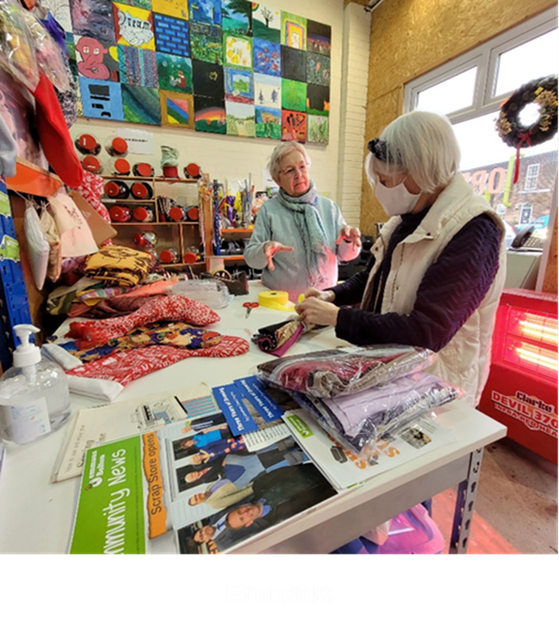
Key Things to Remember – Partnership Grants
All projects that receive funding will need to demonstrate how their proposed project will address one or more of the Bolton’s Fund priorities and how, by working in partnership, the project will be stronger.
Partnership Grant project but the named lead organisation must be able to show that they have experience of delivering similar sized grant funded projects.
Tell us in your application how your proposed Partnership Grant funded project will enable the organisations to test out a new idea that will meet the needs of their beneficiaries and/or extend their current reach and enable more people to access your services.
Emmaus

Slide 10
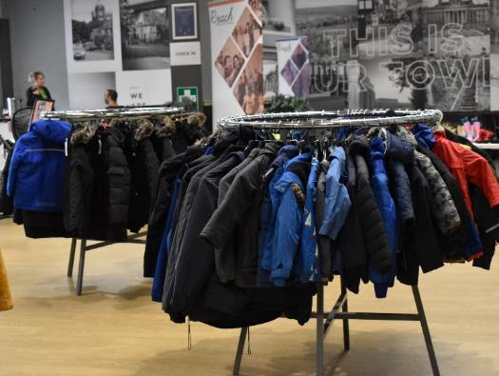
Other Funds
Bolton Community Homes Grants
Charities, community groups, organisations and individuals are invited to apply for grants to help support projects that will benefit BCH customers.
Grant Size – up to £1000 for organisations and micro-grants of up to £100 for individuals.
No closing date. The fund will remain open if funds are available.
Breightmet Community Group

Slide 11
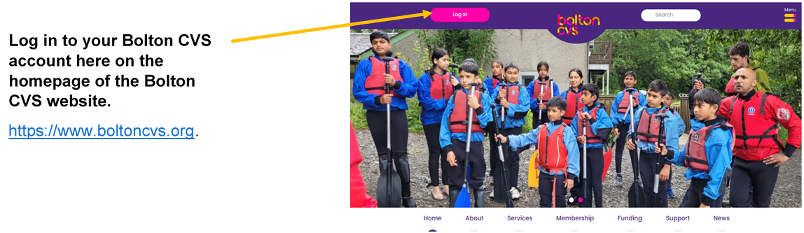
How to apply for grants
Please note:
You will need to create a new account for yourself and your organisation (if you don’t already have one).
Applicants need to complete an Organisation Registration form before applying for a grant.

Slide 12
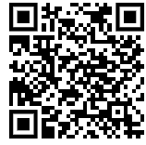
Open4Community – Online Funding Portal
🧡 An online funding search facility which is free for member organisations of Bolton CVS.💜
Search for Government, Lottery and charitable trust funding.
Search and browse functions.
Nearly 600 funders listed!
✨ Easy to Use ✨
😀 Self-service 😀
Link is on the Membership portal section of Bolton CVS website (password protected)
Database is provided by Idox (who run Grantfinder).

Slide 13
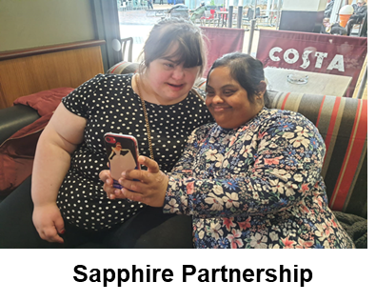
Open4Community – Funding Portal
Functions
Search for Funding using filters and keywords
Filter by:
  Type of organisation
  Area of work
  Type of project
  Type of funding
  Eligible expenditure
  Keywords
Sort your results
Save your results
Downloads items and results
Lots of useful information in the Help & Advice Session

Slide 14
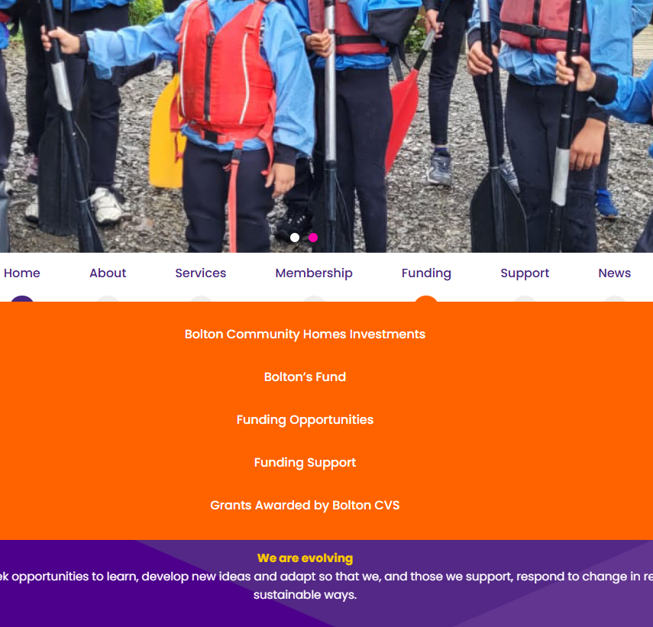
Finding Funding
Access the Funding section from the home page of Bolton CVS website
https://www.boltoncvs.org.uk/
Click on ‘Funding Opportunities’ page.

Slide 15
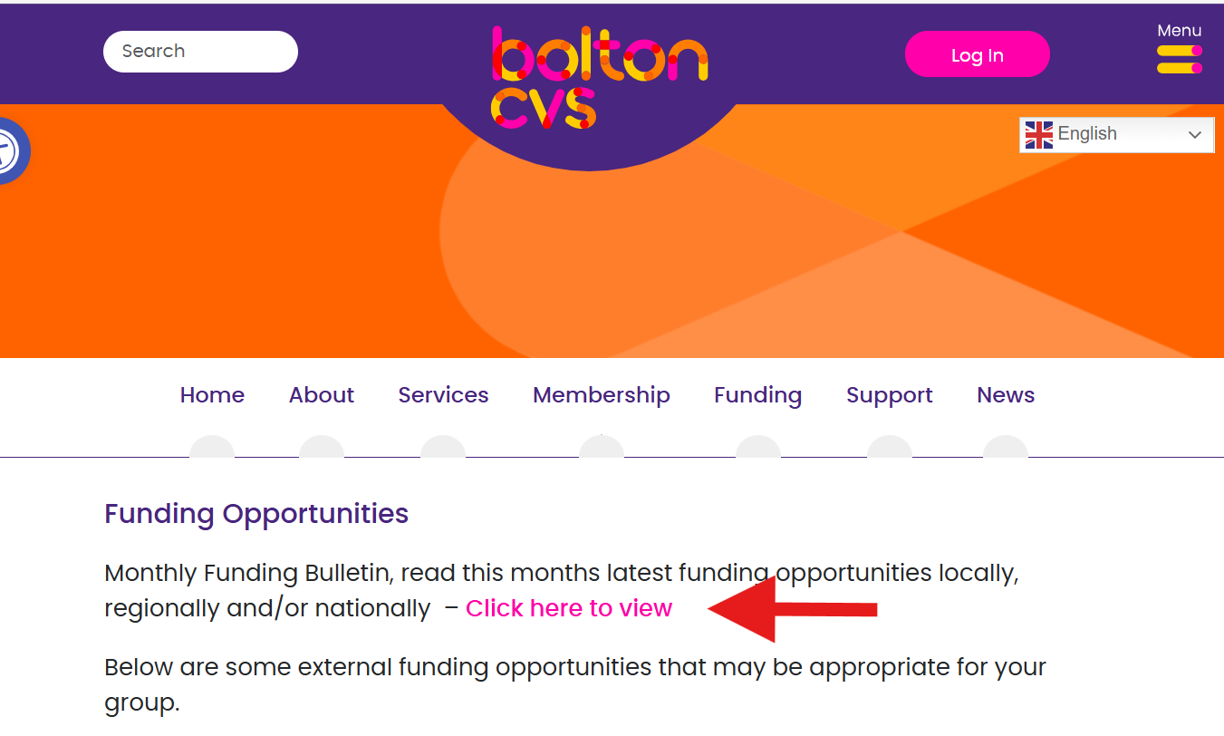
Check out Funding Opportunities and sign up to the Monthly Funding Bulletin
Contact: funding@boltoncvs.org.uk

Slide 16
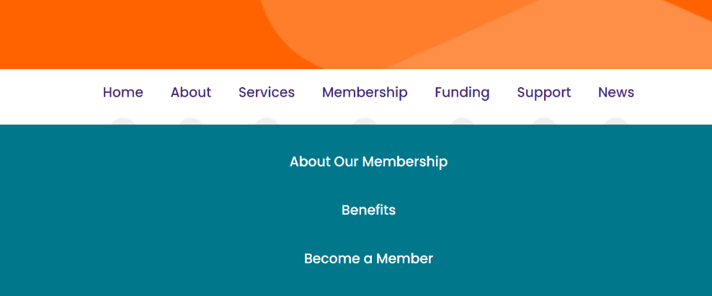
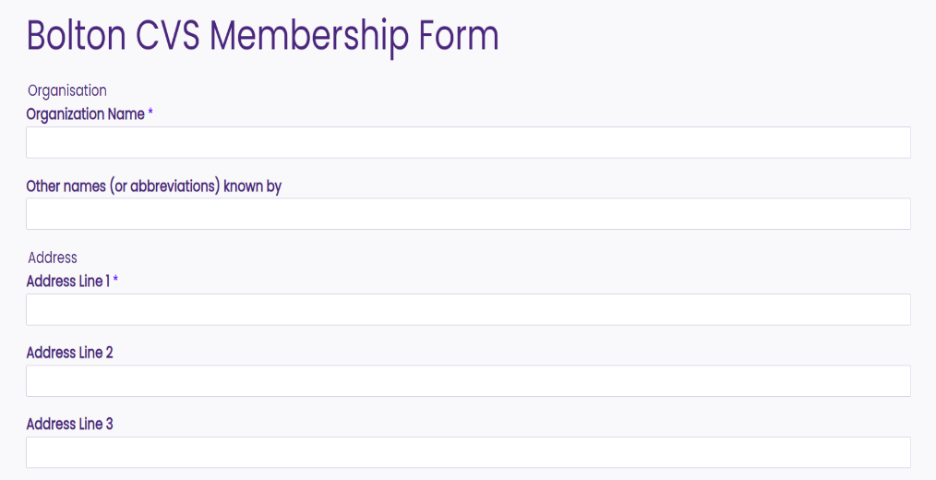
Where to find the Bolton CVS Membership application form

Slide 17
Questions?

Slide 18
Get in Touch
Email: funding@boltoncvs.org.uk
Call: 07783 763901 or 07922 423578
https://www.boltoncvs.org.uk/

Slide 19
