Slide 1

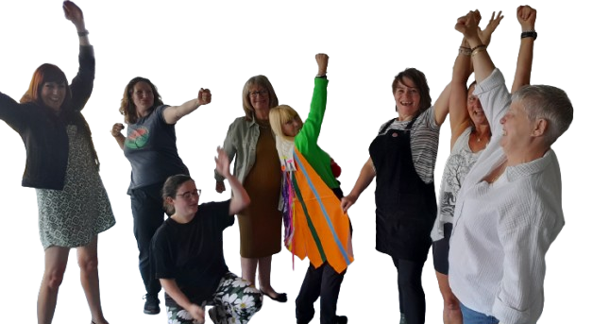
Compassion Circle
Healing-Centred Placemaking

Slide 2
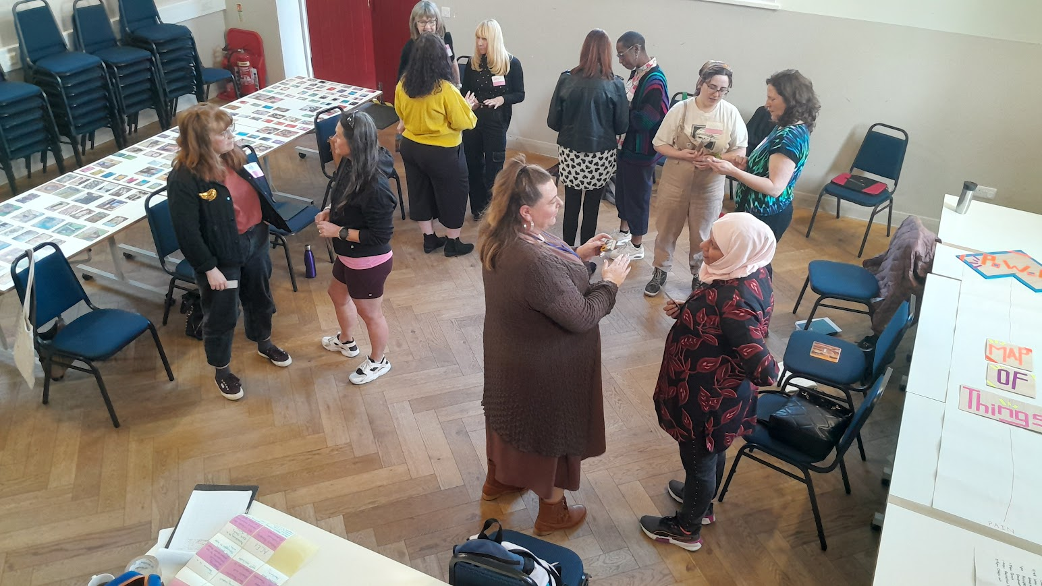
The Purpose
To embed healing-centred and trauma-informed practices across VCSE organisations in Bolton.
Build a supportive Community of Practice
Deliver learning programme to strengthen and support sector
Establish Advocates and Supporters for compassionate practice

Slide 3
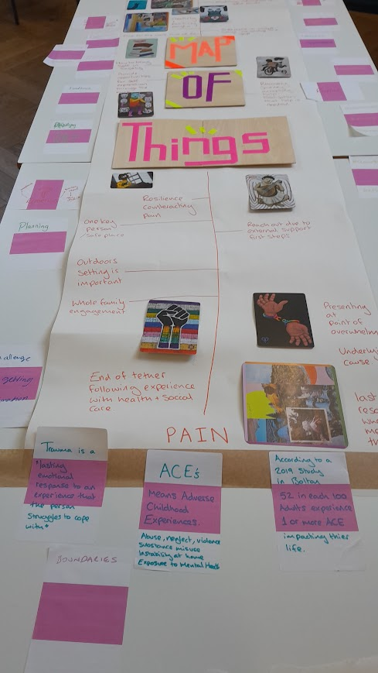
What’s Happened?
7 core sessions delivered, with 2 more planned
24+ individuals engaged in workshops, mentoring, and reflective practice
Ripple Effect Mapping workshop conducted
Evaluation framework developed
Engagement with 25+ VCSE organisations and audit data gathered

Slide 4
What’s Changing?
Personal: Growth in confidence, facilitation, and intentional leadership
Relational: Increased empathy, connection, awareness
Operational: Better boundary setting, inclusive planning, and team sharing
Sector: New training ideas, improved practices, and readiness to scale
Systemic (planned): Micro-Missions to embed healing-centred culture across Bolton

Slide 5
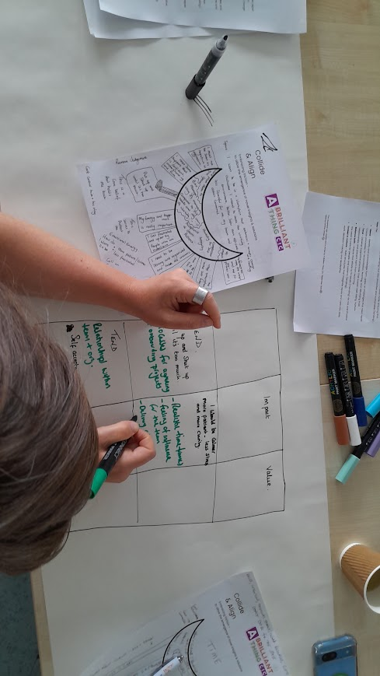

What are we learning?
The programme covers healing-centred foundations, team rhythm, decision-making, and leadership. It explores trauma-informed culture, reflection, and sector impact.
We are exploring money beliefs connected to trauma and how to create community, advocacy, and systems-focused action.

Slide 6
What Matters?
“Thank you for the session today, time to pause, reflect and then act was really powerful for me. I felt so much better, more energised and got loads done this afternoon. Thanks also for agreeing to take a look at my proposal. I really feel the benefit from all we have done together. My confidence in myself and feeling safe in being vulnerable has come on immensely.”
Compassion Circle Participant

Slide 7
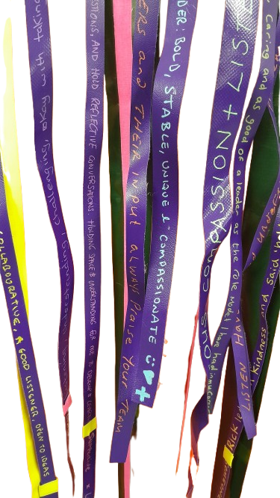
What’s Next?
How can we share compassion across Bolton?
Host events and workshops including:
• Community of Practice (July)
• Compassionate Money Workshop (July)
• Podcast Recording (Sept)
• Compassion Circle Out Loud! (Sept)
Support Advocates through sessions and Reflective Practice
Plan ‘Micro-Missions’ World Mental Health Day collective action

Slide 8
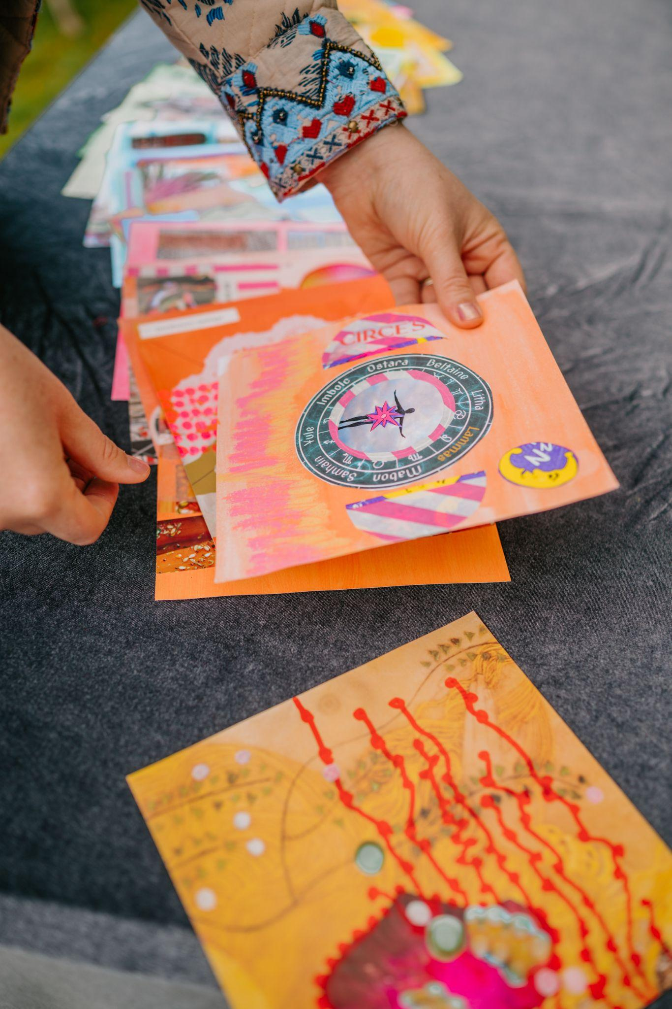
More!
We redesign harmful systems, create healing-centred organisations and help people create brilliant futures.
To find out more about Healing-Centred Design, Compassion Circle and The Brilliant Club visit
www.brilliantthing.co.uk

