Slide 1
Membership at Bolton CVS
Membership is free of charge and simple to apply.
We have two levels of membership:
Steps to becoming a member:
SUBMIT APPLICATION VIA ONLINE FORM
APPLICATION CHECK VIA PHONE CALL
SUBMISSION TO BOARD OF TRUSTEES FOR AGREEMENT
Full Membership: is open to any constituted voluntary and community group or organisation based in and operating within the Borough of Bolton which is sympathetic to our mission and values
Associate Membership: is open to organisations and individuals who are sympathetic to our purpose and values but who do not qualify for our ful

Slide 2
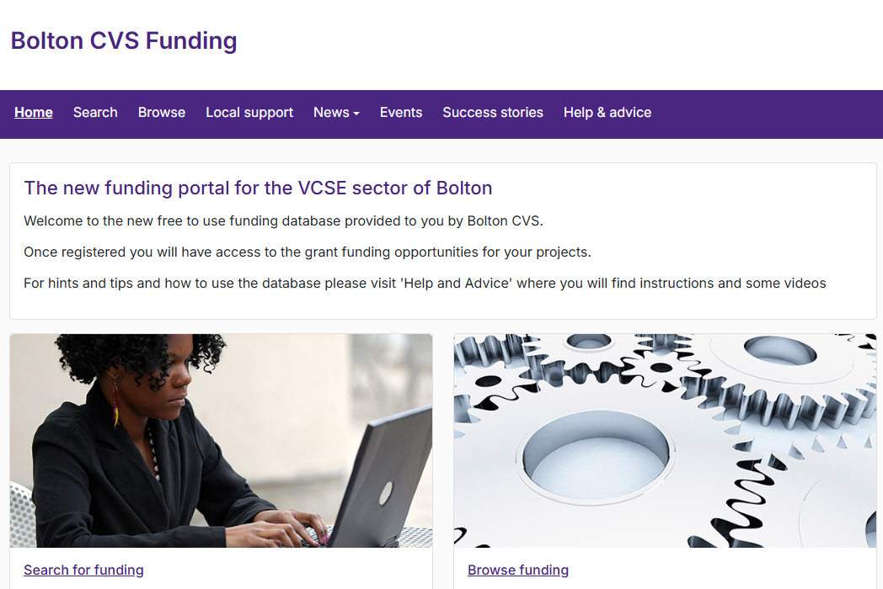
Membership Benefits
Access to the Open4Community Funding Portal
Development support
Access to training and events
Opportunity to be involved in different projects, research and collaborative opportunities with partners
Invitation to different spaces
Vote at the Bolton CVS Annual General Meeting (AGM)
Coming soon: members online portal

Slide 3
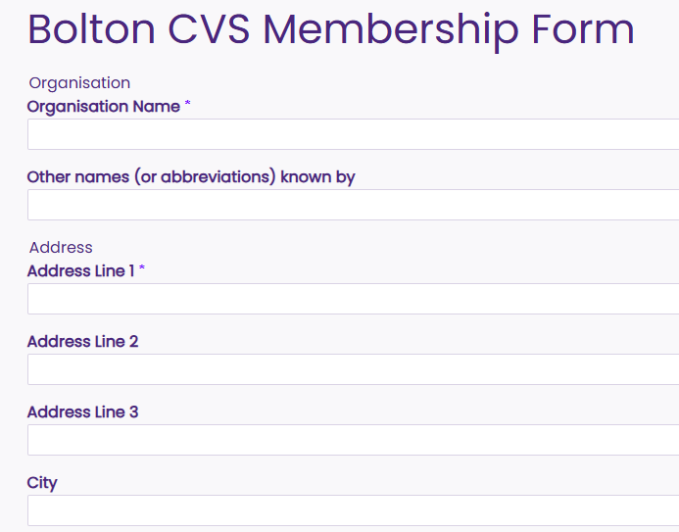
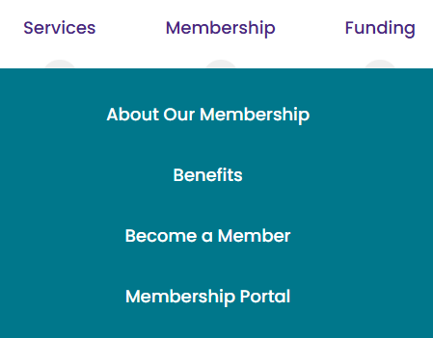
The Bolton CVS Membership Form

Slide 4
Let’s welcome our newest members…
29th May 25

Slide 5
Bolton Symphony Orchestra
27.07.23

Slide 6
Call to Create CIC
27.07.23

Slide 7
Creatives Now CIC
27.07.23

Slide 8
Get Up Keep Going CIC
27.07.23

Slide 9
Nigerian Community In Bolton
27.07.23

Slide 10
The Red Lane Growing Project
27.07.23

Slide 11
Tom Mulenge Music CIC
27.07.23

Slide 12
Unity Drama Group
27.07.23

Slide 13
The Redeemed of the Lord Ministry
27.07.23

Slide 14
Revive CIO
27.07.23

