Slide 1
VCSE STOP SMOKING REFERRAL PATHWAY
Supporting the Health of Our Communities.
Stephen Walker Bolton Smokefree Community Engagement & VCSE Co-ordinator
Mob: 07586022925
swalker@ablhealth.co.uk

Slide 2
What is the VCSE Stop Smoking Referral Pathway?

Slide 3
SMOKING PREVALANCE
NATIONAL AVERAGE
11.9%
BOLTON SMOKING PREVALANCE
15.3%

Slide 4
VCSE Incentive Scheme
£100 for each referral who goes on to set a quit date.
£100 for each referral who is successfully quit at 4 weeks (CO verified).
This money can be utilised to support your organisation’s work.
Quote VCSE Referral on phone/email/referral form.
Max 2 referrals for any one individual in a 12-month period.
Payment for referrals & four week quits is made quarterly
Payments must be made into an official organisation bank account.

Slide 5
What happens next
Evidence based support tailored to the individual client needs.
Clients are supported weekly for 12 weeks Follow Up 26 and 52 weeks
Open door policy
Access to medication – Free direct supply of NRT and vapes
Work in partnership with all stakeholders to support hard to reach clients.
Smokers are 3 times more likely to quit with specialist support

Slide 6
WHY is it important?

Slide 7
THE EFFECTS OF SMOKING!

Slide 8
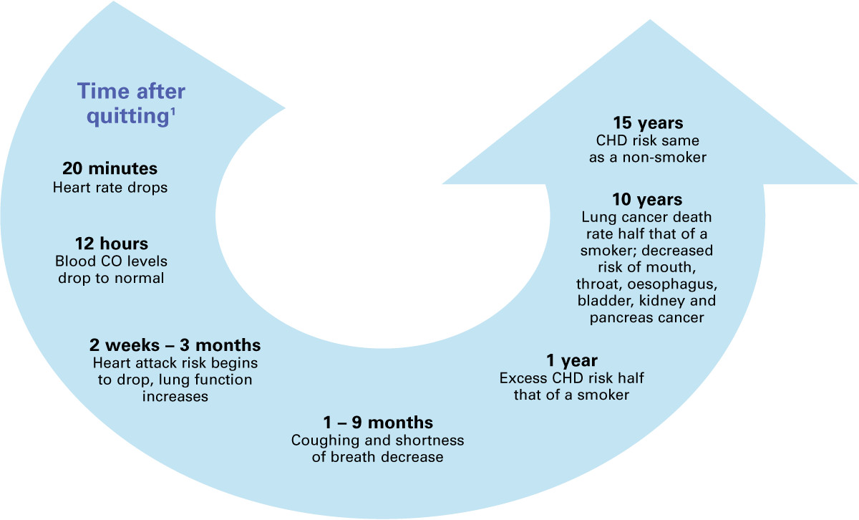
HEALTH BENEFITS OF QUITTING START IMMEDIATELY.
1. US Department of Health and Human Services. The Health Consequences of Smoking: what it means to you. U.S. Department of Health and Human Services, Centers for Disease Control and Prevention, National Center for Chronic Disease Prevention and Health Promotion, Office on Smoking and Health, 2004. Available at: http://www.cdc.gov/tobacco/sgr/sgr_1988/index.htm Accessed July 2006.

Slide 9
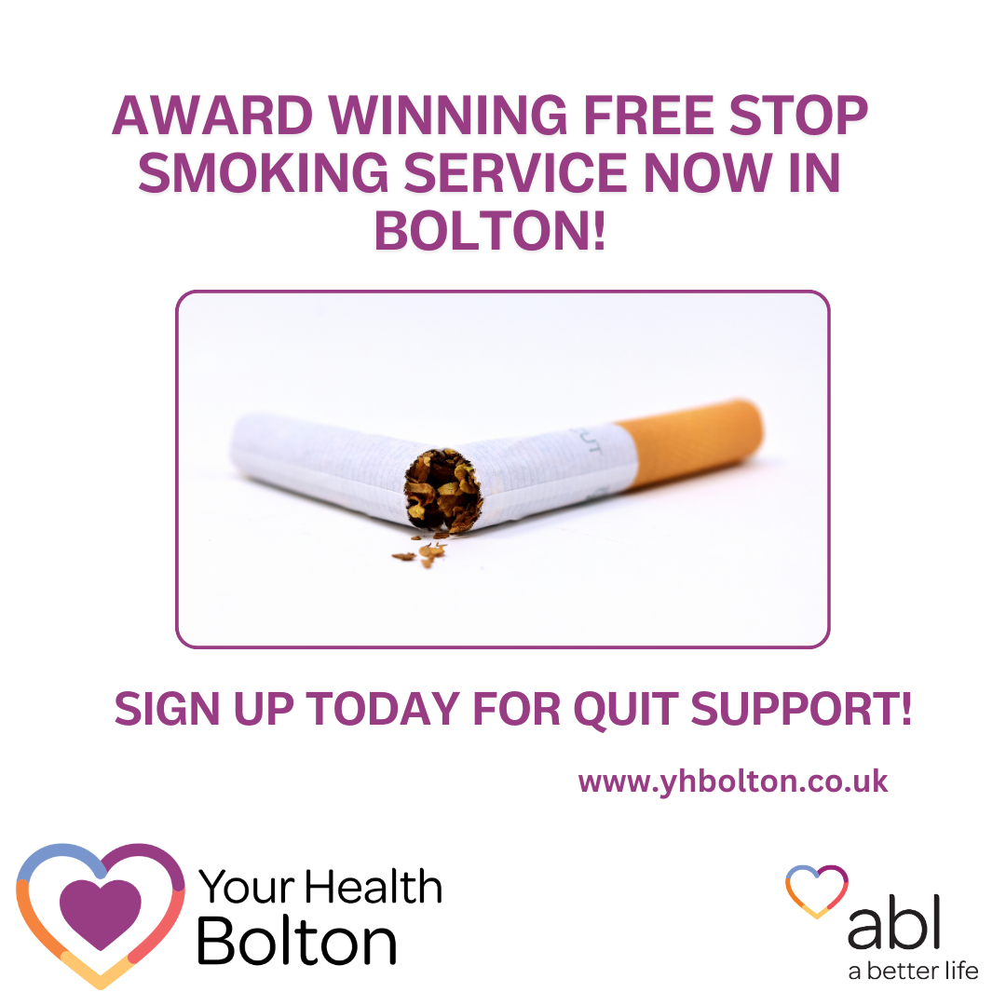
Higher smoking rates seen in –
The unemployed and those in lower-paid jobs.
Routine & manual workers.
Around one third of adult smokers are people with a current mental health condition.
Those in social housing.
LGBTQ+ community.
The good news…..
Most smokers say they want to stop.
Quitting smoking at any age is the best thing you can do for your health – when you stop there are almost immediate improvements to a person’s health.
Making smoking history will save 64,000 smoking related deaths annually in England.
Making smoking obsolete in England would lift around 2.6 million adults and 1 million children out of poverty. Financially people save around £2,000/year by quitting.
Getting expert support from your local stop smoking services means you’re 3 x as likely to quit for good.
Nicotine vapes are one of the most effective stop smoking aids. Almost two-thirds of people who use a vape along with support from their local Stop Smoking Service successfully quit smoking.

Slide 10
Brief Intervention.
Thirty seconds to save a life!

Slide 11
Raise the issue at any appropriate time
Ask
Advise
Act
“Can I ask if you smoke?”
“How do you feel about your smoking?”
Build confidence
“Did you know that you’re 3 times more likely to succeed at stopping smoking and remain stopped with specialist support and medication? They don`t judge and can offer both of these to you in ……. including vapes and it`s free. It will be the best thing you can do ”
“ With your consent I am going to make a referral so you can receive specialist support, or you can self-refer
Notes:
People say I’ve tried and tried and nothing works – A lot of time people don’t use products correctly and don’t have support – We are here to support.
If you want further team training we can accommodate this. EW and me can support

Slide 12
What happens next
VCSE referrals by phone on:
01204 205090
VCSE referrals by email:
Yourhealth.bolton@nhs.net
VCSE referrals via our website: https://yhbolton.co.uk/vcse-referral/

