Slide 1
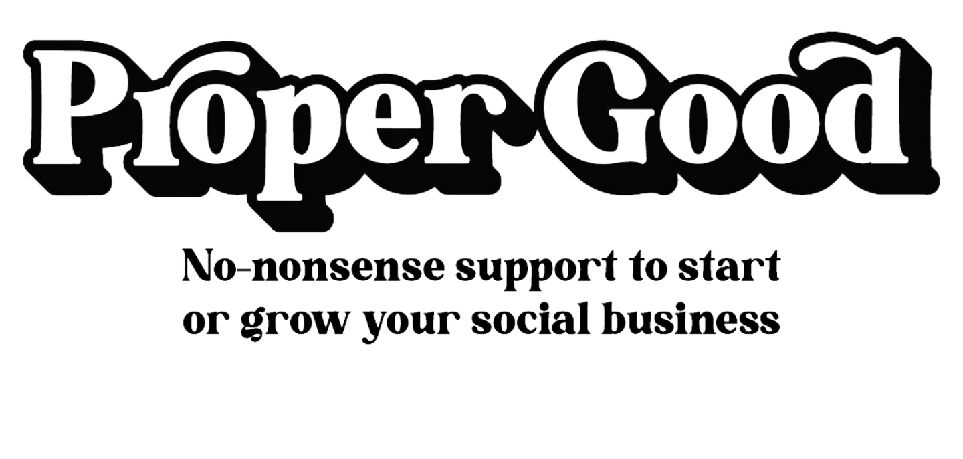
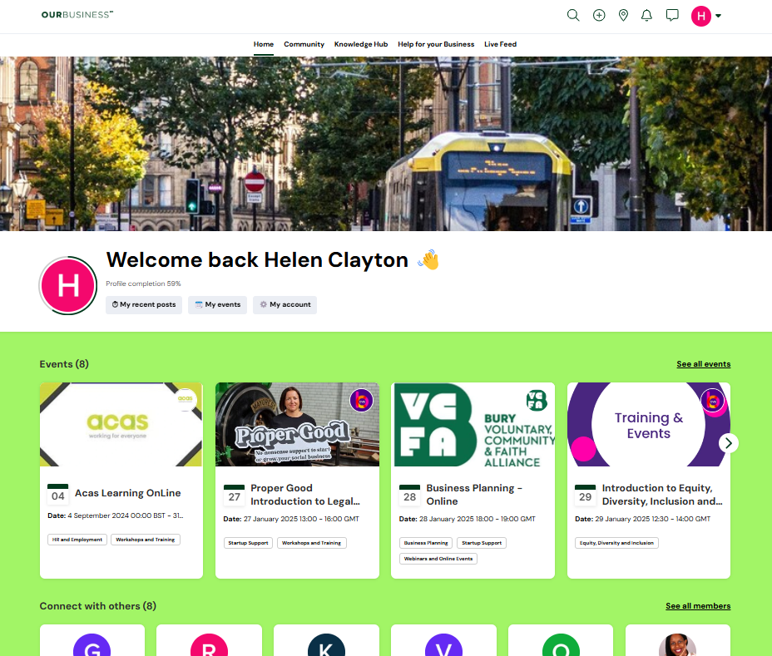
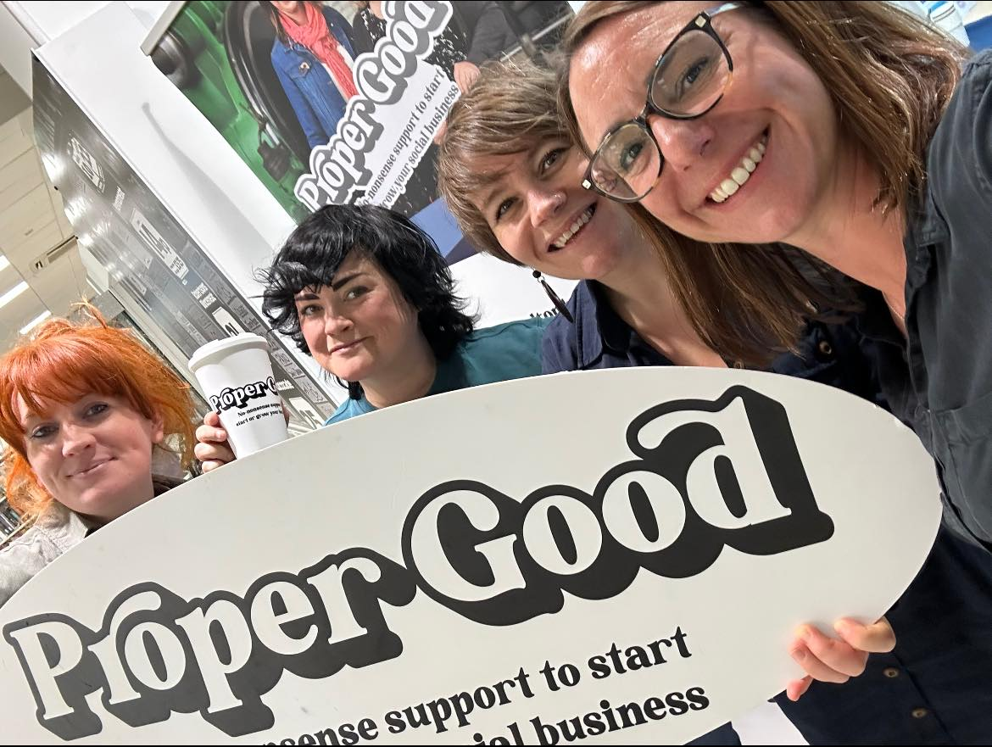
Notes:
A programme of business support, delivered in Bolton, designed specifically for your socially-minded or charitable organisation.
Social enterprises and socially minded businesses.
Proper Good is a joint funding programme established by Access and Better Society Capital that aims to support the development of stronger, more resilient and sustainable social economies by helping social enterprises to develop and thrive.

Slide 2
Social Enterprises
Notes:
Who is here from a social enterprise?
What is the definition of a social enterprise?

Slide 3
Social Enterprises
There is no single, legal definition of a social enterprise
Any organisation that:
Aims to generate over half its income through trade
Has a clear social mission enshrined in its governing documents,
with an accompanying asset lock,
……is a social enterprise.
SEs incorporate themselves in lots of different ways - from CICs & Charitable Incorporated Organisations (CIOs), Charities, Co-ops, Community Benefit Societies & Co-operatives all the way up to Private companies limited by shares and trading charities.
-

Slide 4
Trade
Your charity is trading if it sells goods or services to customers with the aim of generating income.
Contracts with the local authority can count as trading. For instance, if a local authority contracts a charity to provide a service (such as running a community centre or providing care services) and pays the charity for that service, this would typically be considered trading.
Notes:
In the UK, "trading" for charities refers to activities that involve selling goods or services in a commercial manner, with the aim of generating income. These activities are distinct from a charity’s primary purpose of pursuing charitable objectives. For example, if a charity operates a shop or provides paid services, that would be considered trading.
When it comes to contracts with the local authority, it can count as trading if the charity is being paid for services in a way that is more akin to a business transaction, rather than a charitable grant. For instance, if a local authority contracts a charity to provide a service (such as running a community center or providing care services) and pays the charity for that service, this would typically be considered trading.
However, the key distinction is that if the contract directly supports the charity’s charitable purposes, such as delivering a project that furthers the charity’s mission (rather than just being a financial transaction), it may be viewed more as a grant or funding, rather than trading. This can sometimes be a grey area, and each situation is considered on a case-by-case basis.
If a charity is trading (including contracts with local authorities), they may be subject to taxation on that income, depending on the nature of the activity and whether it qualifies for any exemptions (for example, if the trading income is used for charitable purposes, there could be reliefs available).

Slide 5
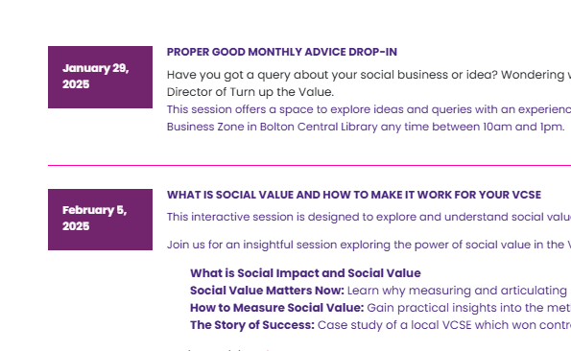
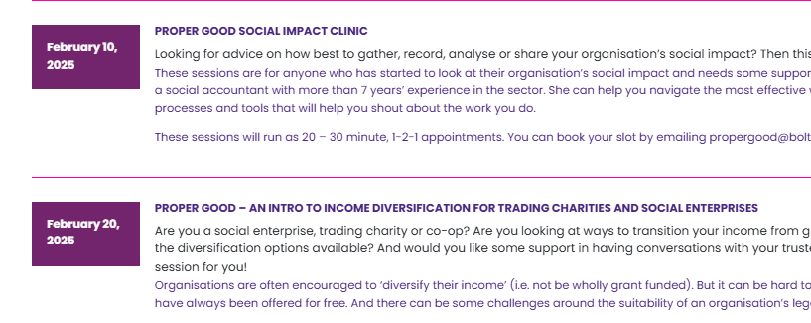
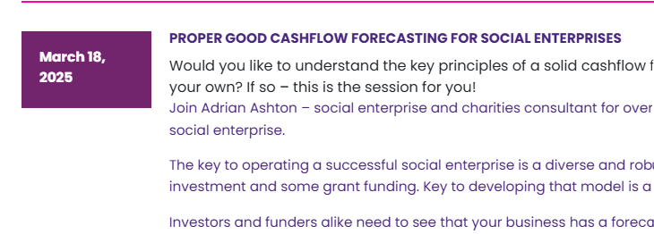
Is Proper Good for you?
Notes:
If you are looking to diversify income

Slide 6
Where can you find our info?
www.boltoncvs.org.uk
propergood@boltoncvs.org.uk
Facebook – Proper Good Bolton

