Slide 1
Membership at Bolton CVS
Membership is free of charge and simple to apply.
We have two levels of membership;
Full Membership: is open to any constituted voluntary and community group or organisation based in and operating within the Borough of Bolton which is sympathetic to our mission and values
Associate Membership: is open to organisations and individuals who are sympathetic to our mission and values but who do not qualify for our full membership.
Steps to becoming a member:
        SUBMIT APPLICATION VIA ONLINE FORM
        APPLICATION CHECK VIA PHONE CALL
        SUBMISSION TO BOARD OF TRUSTEES FOR AGREEMENT

Slide 2
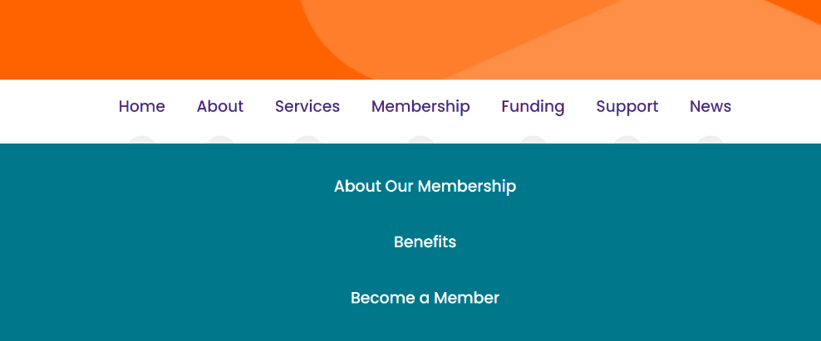
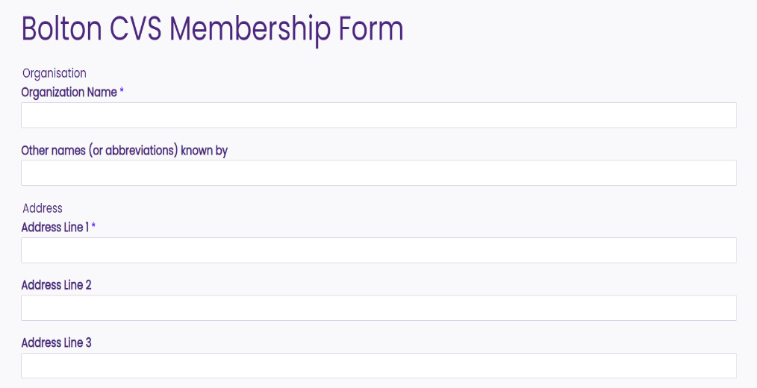
Where to find the Bolton CVS Membership application form

Slide 3
Let’s welcome our newest members
30th January 25

Slide 4
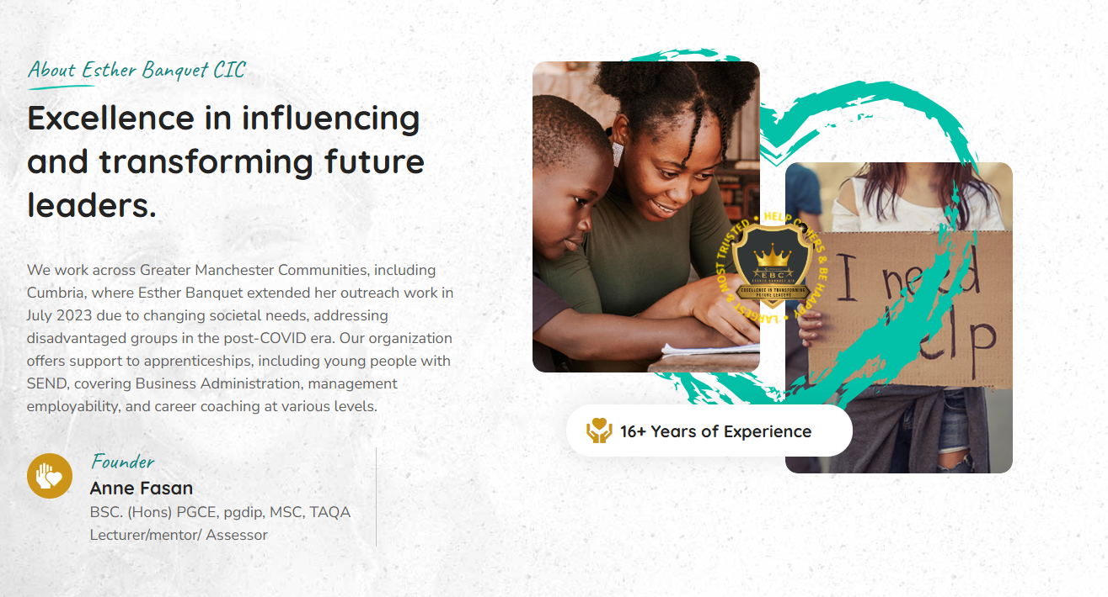
Esther Banquet CIC

