Slide 1


Sustainability Check Ins

Slide 2
What do we mean by Sustainability?
“Meeting the needs of the present without compromising the ability of future generations to meet their own needs”
The United Nations
Notes:
Global challenge, affecting everyone at every level of society

Slide 3

The United Nations Sustainable Development Goals
Big challenges need bold action to overcome them, and that is where the Global Goals come in. They are a plan agreed to by all world leaders to build a greener, fairer, better world by 2030, and we all have a role in achieving them.
Notes:
UN goals establish global consensus around the areas in which we need to see sustainable development – not just about environment, but people too. Everything is connected.

Slide 4
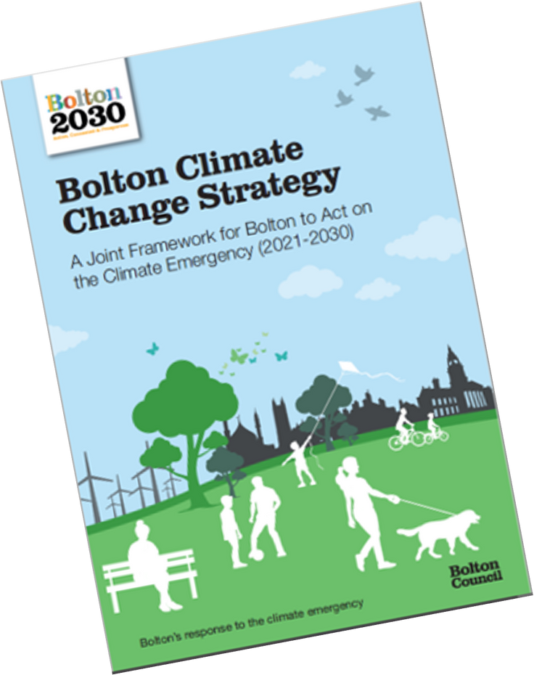
What about in Bolton?
Bolton Council declared a Climate Emergency in 2019
We have a Bolton Climate Change Strategy.
We have an ambition to make council operations net-zero carbon by 2030
Notes:
Big global challenges need local as well as global responses. Local strategies and approaches are more likely to be effective as they consider the local context. The VCSE sector is hugely important in this – we are connected to, run by and serving our communities, so we have the best ideas of the best approaches to meet some of these big challenges.

Slide 5
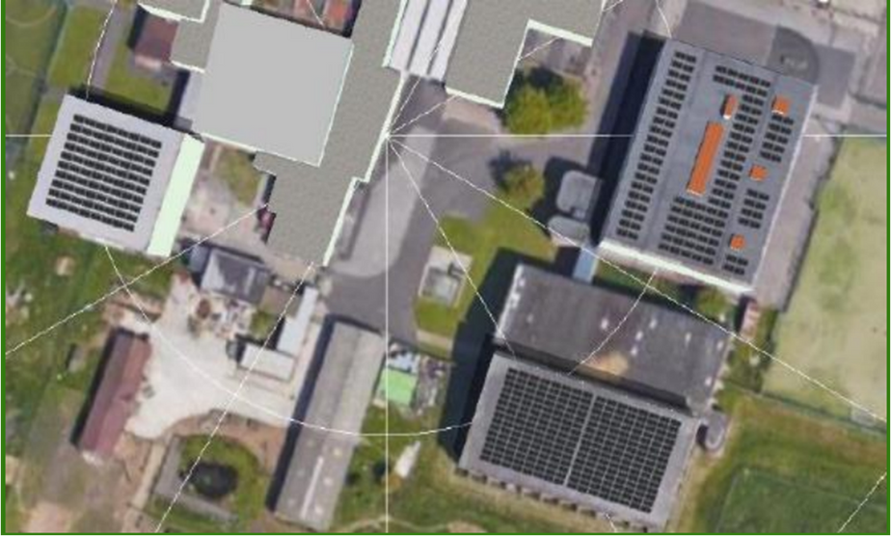
Examples of action in Bolton
  The council is looking at ways to save energy in the buildings it owns, such as schools and council office buildings.
  They received £4.2million grant from the government to install energy efficiency measures and renewable technologies in 13 buildings including Ladybridge school.
  Bolton at home received £2million from the government to install energy efficiency upgrades in 200 properties.
Solar array on Ladybridge High School

Slide 6

What is a Sustainability Check In?
A chance to have a conversation about the changes your organisation can make to reduce your environmental impact and influence change
Notes:
We want to support you to engage in a process of evaluation – to empower you to acknowledge the good work you are already doing and explore areas where you could make small changes or have influence. To support your organisation to be part of Bolton’s journey to a sustainable town.

Slide 7

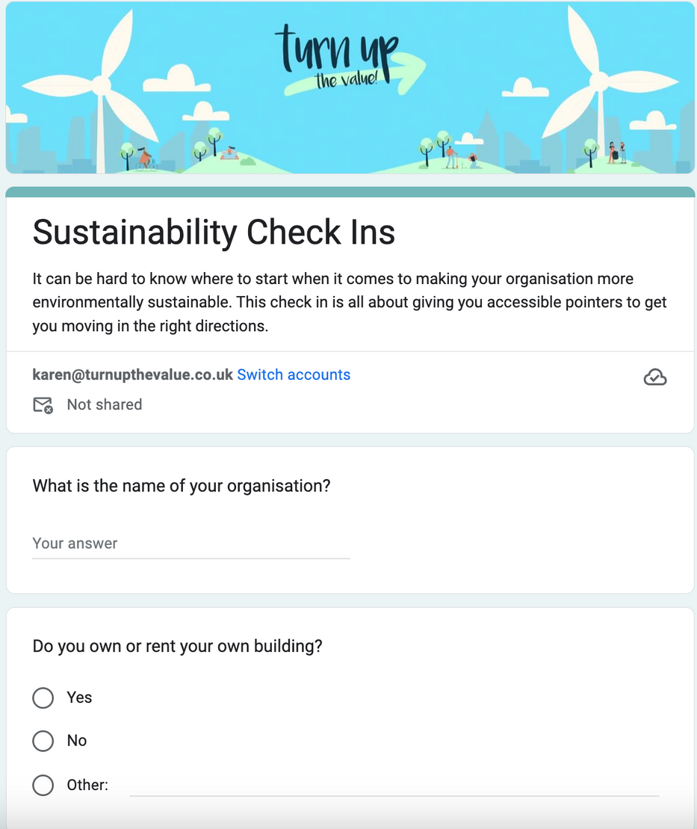
Sustainability Check Ins
STEP ONE: One to one coaching session with opportunity to make pledges
STEP TWO: Agreeing an action plan
STEP THREE: Developing an Environmental Policy

Slide 8
What are the benefits?
Cost savings
Saving energy, waste, water saves money
Organisational reputation
Both internal and external - including staff, customers, funders and commissioners
VCSEs are well placed to make a difference
Supporting the most vulnerable, located in heart of communities, understand what is needed

Slide 9







What could your organisation do?
Energy
Waste
Food
People Power
Travel
Nature
Water

Slide 10
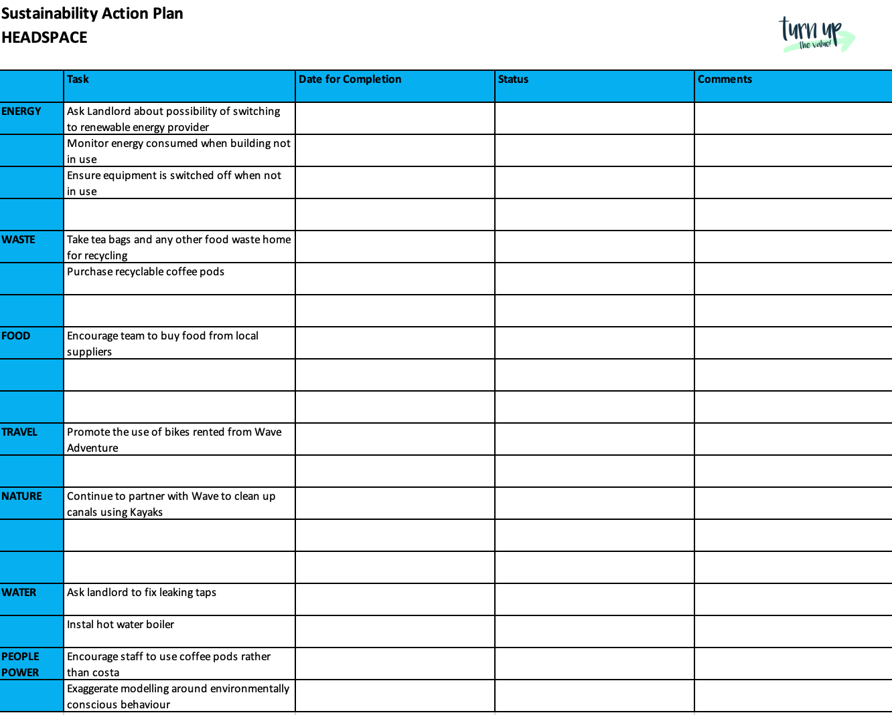


Slide 11
"the most useful thing about this was knowing that we were already ahead of the game in so many areas particularly the sustainable travel as we support people to access bikes and public transport.
In relation to our future funding, it was very useful to understand the changes we wanted to make for a sustainable future - that as an organisation we can be really proud of."
Ginny Allende Director, Headspace CIC

Slide 12

Developing your Environmental Policy
WHAT IS IT: A written statement of your organisation’s commitment to environmental sustainability.
PURPOSE:To communicate your organisation’s commitment sustainability, reinforcing it as a priority to your organisation and encouraging your stakeholders (including staff, trustees, volunteers) to include it in decision-making.
Now an important requirement for many funders!
Notes:
Following on from check-in and action plan – Env. Policy. Follow on appointment to draft with Karen.

Slide 13

How can Bolton CVS help?
  Do you need any support from volunteers? CVS can help you recruit and manage volunteers who could help you achieve your goals
  Do you need any funding? CVS can help you to apply for any additional funding support you might need
Email: info@boltoncvs.org.uk
Notes:
And if your action plan or policy throw up issues/projects etc…

Slide 14

Book your check in with Turn Up the Value by contacting Lisa Forest - lisa@boltoncvs.org.uk to see how your VCSE organisation can take the small steps that make all the difference
Email: karen@turnupthevalue.co.uk
Phone: 07875934693

