Slide 1
Bolton CVS
Open Funds – May 2024
Liz McNabb
Funding and Grants Manager

Slide 2

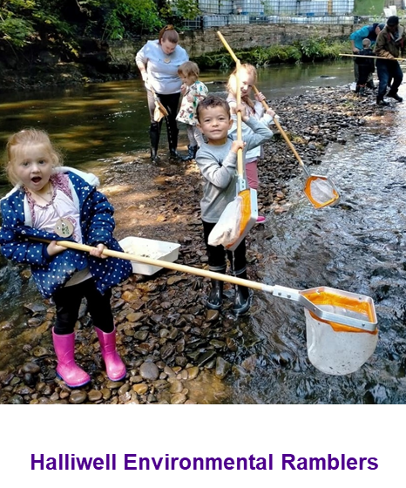
What is Bolton’s Fund?
Bolton’s Fund is a grants programme.
Short term funding (maximum 12 months).
Supports delivery of projects and activities.
It benefits people and communities across the Metropolitan Borough of Bolton.
It exists to support the VCSE sector in Bolton to grow and thrive.
Bolton CVS are contracted by Bolton Council to administer Bolton’s Fund and provide support for groups across all stages of the application process.
Notes:
Definition of a grant:
Grants are a specific amount of funding given to an organisation for specific activity to be delivered within a specific time frame.

Slide 3

Eligibility grant levels
Name of Grant | Max size of grant | Eligibility (based on income level) | Size of group.
Micro | £2,000 | Less than £100,000 per year | Micro and Small
Small | £5,000 | Over £10,000 and under £1m | Small and Medium
Medium | £15,000 | Over £100,000 per year | Medium and Large
Large | £25,000 | Over £1m per year | Large

Slide 4
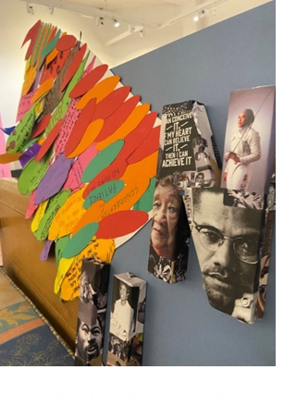
Priorities of Bolton’s Fund
Start Well – giving children the best possible start in life.
Live Well – improving the happiness and wellbeing of Bolton residents.
Age Well – helping older people stay connected, active and healthy in their communities.
Prosperous - supporting enterprise, inclusive employment and maximising social value for Bolton.
Clean and Green - protecting, improving and enjoying our environment.
Safe, Strong and Distinctive – creating safe, stronger, cohesive and more confident communities.
Notes:
All projects that receive funding will need to demonstrate how their proposed project will address one or more of the Bolton’s Fund priorities. The priorities are guided by Bolton 2030 Vision priorities.

Slide 5
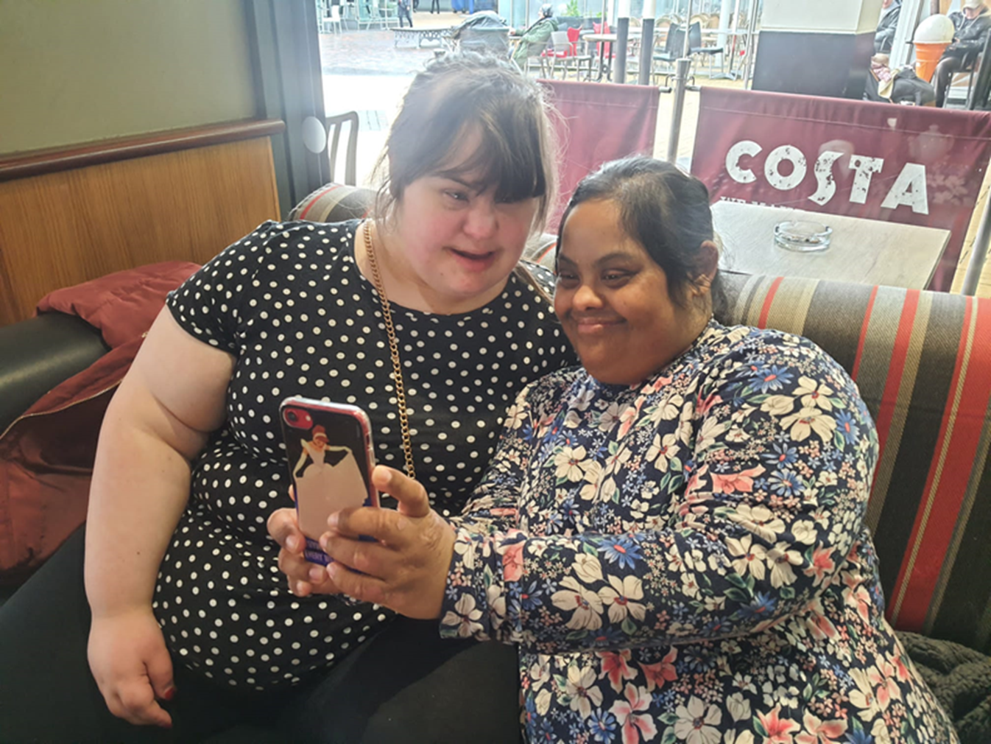
Deadlines
Applications to Micro and Small Grants
Rolling deadline
Applications to Medium and Large Grants
Six application deadlines per year – next one in early July
Partnership Grant fund to be launched Summer 2024 – this will replace the Large Grants fund.
Please allow at least 6 – 8 weeks for decision
Unsuccessful applicants can re-apply
The fund will only close if all the funding for the period has been allocated.
Sapphire Partnership

Slide 6
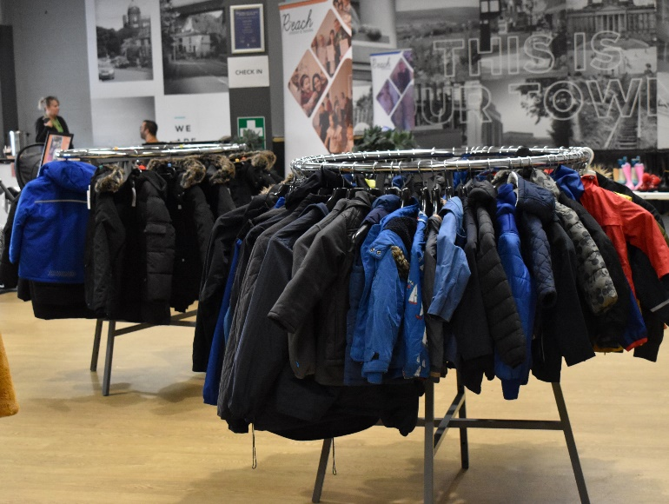
Other Funds
Bolton’s Fund: Household Support Fund 5
Large grants (up to £15,000).
Provision of crisis support to vulnerable household in the most need with the cost of essentials.
  Energy and energy saving
  Food
  Wider Essentials
  Debt and benefit advice services.
£250,000 through Bolton’s Fund. Via the Department for Work and Pensions.
Closing date 23rd June 2024.
Bolton Community Homes Grants
Charities, community groups, organisations and individuals are invited to apply for grants to help support projects that will benefit BCH customers.
Grant Size – up to £1000 for organisations and micro-grants of up to £100 for individuals.
No closing date. The fund will remain open if funds are available.
Breightmet Community Group

Slide 7
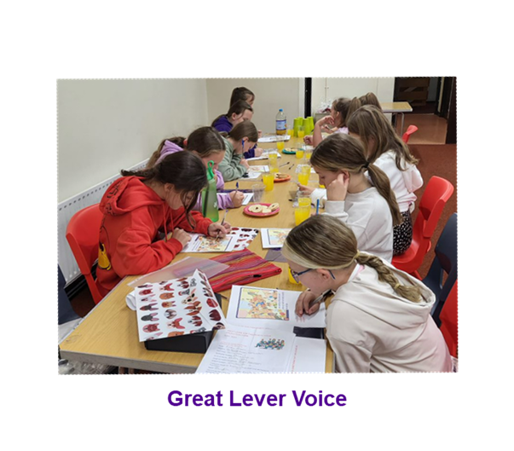
Funding Opportunities page on Bolton CVS website
My Funding Central
Funding search engine to help you find funds which may be suitable for your project ideas.
Free service for organisations with an income of less than £30,000.
Local, national and international funding opportunities for charities.
Monthly Funding Bulletin
Produced by colleagues across Greater Manchester
By local theme and by theme (e.g arts, health and wellbeing, sports etc.)
Bolton CVS Monthly Funding E-newsletter
We list other funding opportunities on this page as we find them so it’s worth checking.

Slide 8
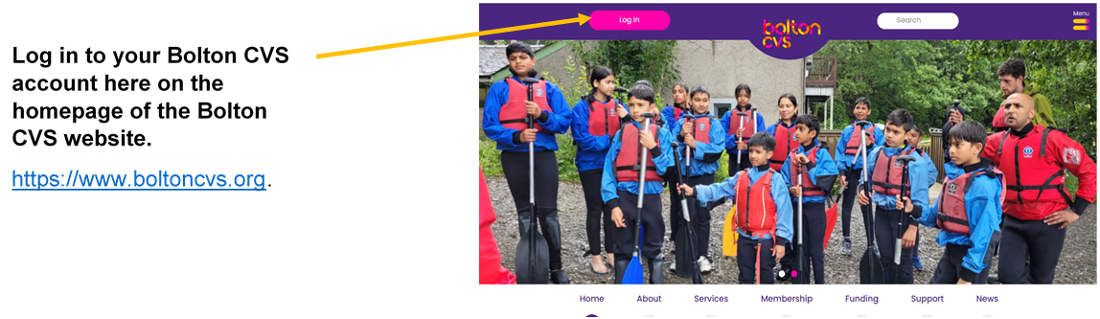
How to apply
Please note:
You will need to create a new account if you don’t already have one
Applicants need to complete an Organisation Registration form before applying for a grant

Slide 9
Get in Touch
Email: funding@boltoncvs.org.uk
Call: 07783 763901 or 07922423578
https://www.boltoncvs.org.uk/

