Slide 1
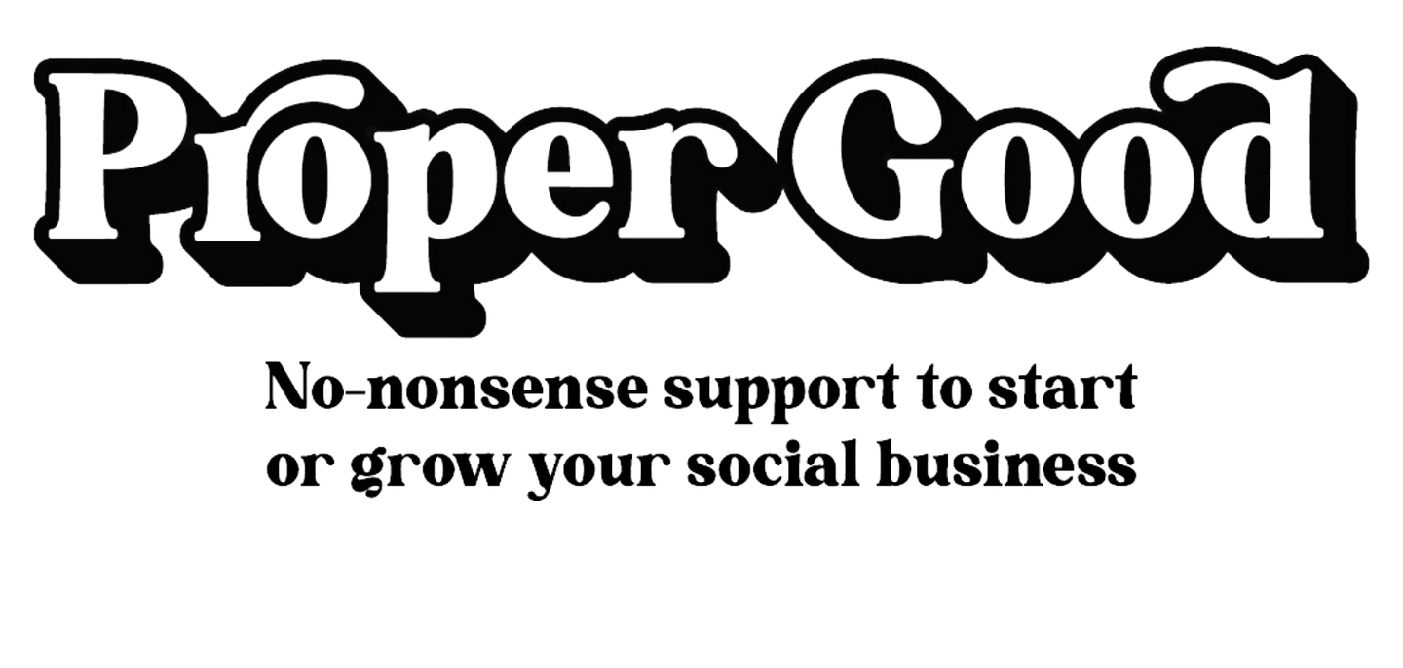
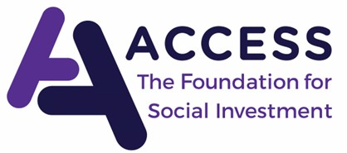
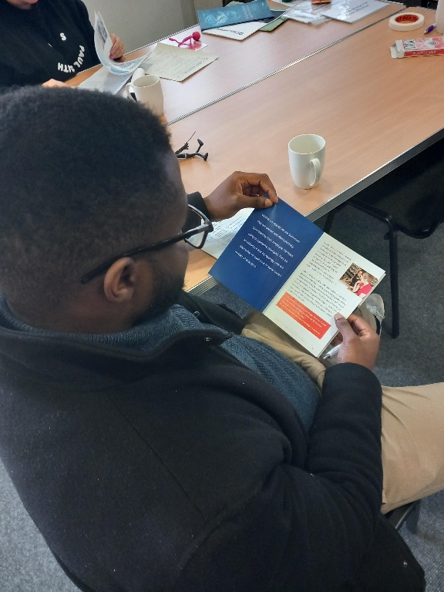
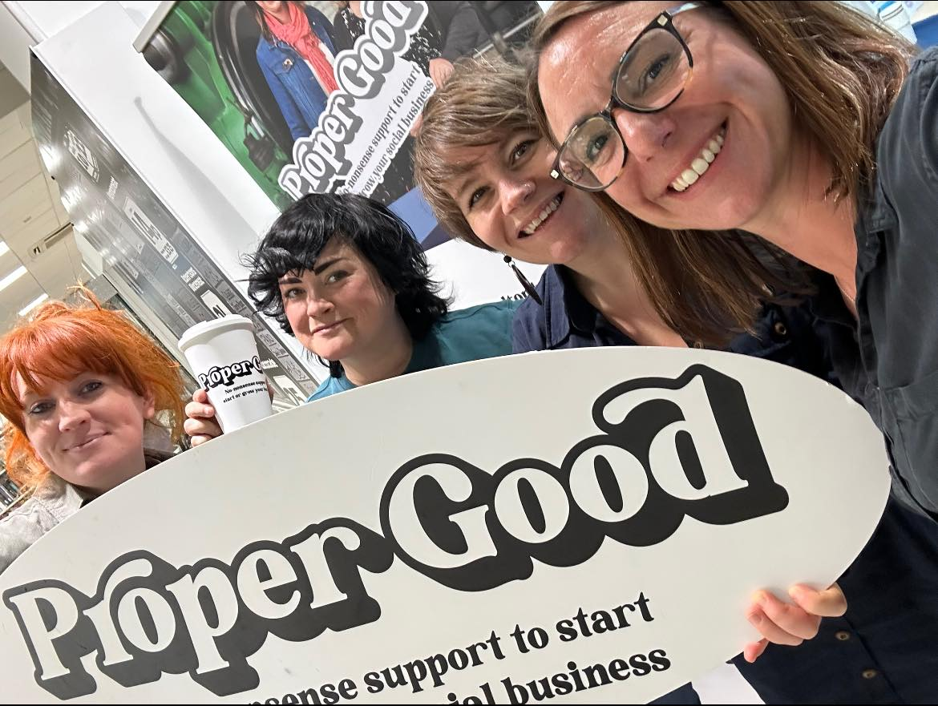
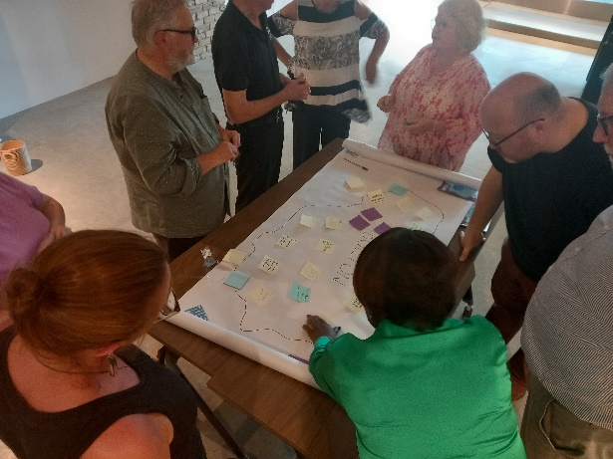

Slide 2
Proper Good
Proper Good is a joint funding programme established by Access and Big Society Capital that aims to support the development of stronger, more resilient and sustainable social economies by helping social enterprises to develop and thrive.

Slide 3
Proper Good
The programme exists in 6 localities across the country, and has a different name in each!
Here in GM we are Proper Good, and the funding is split across four areas:
Bolton
Oldham
Wigan
Stockport

Slide 4
Proper Good
In 2022 Greater Manchester was awarded just over £8,200,000 for social enterprise support & blended finance
The funds have been split
£2 million to local delivery partners to support and develop social enterprises in their Borough
£6.2 million to be distributed as social investment to help social enterprises grow
Notes:
The Places deliver Enterprise support.

Slide 5
Social investment (loans)
There are two pots of investment available:
Early Stage
For organisations in the early stages of their journey in terms of trading
Unsecured loan up to £30,000
Interest free
1 - 3 years, 3 months no repayments to build income

Slide 6
Social investment (loans)
Buildings Fund:
Investments of up to £350,000 of blended finance, a mixture of 90% loan and 10% grant
For organisations with an interest in:
Purchasing
Building
Renovating
Refurbishing

Slide 7
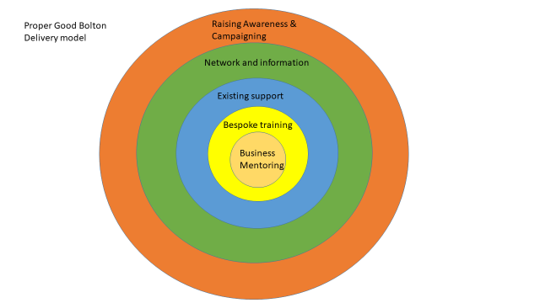
Proper Good in Bolton
Social Enterprise Support
Tailored training workshops
Support at Drop-In’s
Social Enterprise Network
Sign posting
Seed funding for early stage SE’s
Business Mentoring & grant scheme

Slide 8
The Proper Good Team
Helen Clayton – Project Supervisor
Lisa Forrest- Project Co-ordinator
Steering Group
We work with external delivery partners to bring the best expertise from GM to the sector in Bolton. They include, but are not limited to:
Karen Smith – Turn Up The Value
Adrian Ashton
Jenny Matthews– The Enterprise Bridge CIC
Kirsty Day - Yellow Jigsaw

Slide 9
What is a Social Enterprise?
and could you be one..?
Social enterprise is a woolly term – no legal definition
For Proper Good purposes - an incorporated organisation that is actively trading, with an express social mission documented in its articles, and an asset lock
This could be:
- a trading charity
- a Co-op
- a Community Benefit Society
- a company limited by shares
- a CASC

Slide 10
How can Proper Good support you
Workshops to build skills and knowledge
e.g. legal structures and governance, social impact and accounting, business planning
Advice clinics and drop-ins for 1:1 conversations with SE experts
Opportunities to connect with other SE’s in Bolton – networking events, co-working days, social media campaigns
Business mentoring
Seed Funding- to start or develop something new

Slide 11
How can Proper Good support you
Our programme activity is open to SE’s regardless of size – start-ups and large established organisations are equally welcome.
All Proper Good workshops are listed on the Stronger Together training page of the Bolton CVS website.
Updates about other events are shared via our Facebook page and through our newsletter.
If you’d like to stay up-to-date about Proper Good happenings, email Lisa on propergood@boltoncvs.org.uk and I’ll add you to our mailing list.

Slide 12
Working with Bolton CVS colleagues
Sitting within CVS gives us a huge opportunity to support the many groups who are recognising enterprise as a viable route to sustainability
Support you to recognise you are a social enterprise
Encourage and support trading for income diversification and sustainability
So if you think we could support you and your organisation – get in touch!
Notes:
Ask of the Team…

Slide 13
Where can you find our info?
www.boltoncvs.org.uk
propergood@boltoncvs.org.uk
Facebook – Proper Good Bolton

Slide 14
Any questions…?

