Slide 1
Bolton NHS Talking Therapies: for anxiety and depression
Ruth Lowe
Senior Psychological Wellbeing Practitioner
Improving Lives

Slide 2
Bolton NHS Talking Therapies
Bolton NHS Talking Therapies provides free, confidential talking therapies for adults aged 16yrs and over.
We have previously been known as Bolton Primary Care Psychological Therapy Service (BPCPTS) or Bolton IAPT however we continue to offer the same service as before.
We have also moved back to 33 Victoria Square in the Town Centre.
Our team consists of:
Psychological Wellbeing Practitioners (PWPs)
Cognitive Behavioural Therapists (CBT)
Psychology
We also work closely with 1point who provide Counselling.

Slide 3
NHS Talking Therapies (IAPT) and Long-Term Health Conditions
Around 40% of people with depression and anxiety have an LTC
If left untreated, mental health problems can have a significant impact on the person’s physical health.
Mental health problems can affect a person's engagement with the treatment of their physical health problem therefore reducing their ability to self-manage effectively
It also increases the person’s likelihood of unhealthy behaviours such as smoking and poor diet worsening the person’s physical health
There are poorer employment outcomes, including a higher risk of absenteeism and unemployment.
NHS Talking Therapies aims to work with physical health providers in an integrated and coordinated way helps to achieve the best outcomes for all people, irrespectively of their LTC diagnosis.
Notes:
We currently have therapists (CBT and PWP) who are trained to work with people who’s main problem is that their depression or anxiety is caused by their Health Condition. This often involves making adjustments within therapy, for example ensuring that people are not doing to much/to little due to their chronic pain or fatigue. The work often involves working alongside other health care professionals (such as pain management services, physiotherapists) as well as GP’s.

Slide 4
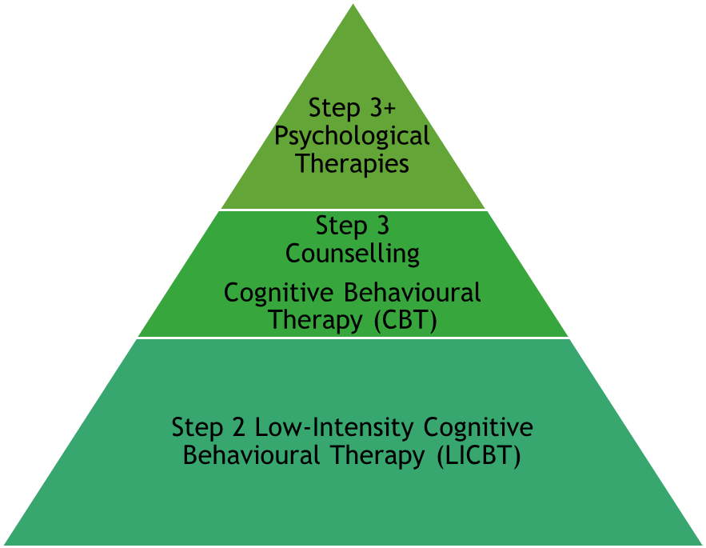
Stepped Care within Bolton NHS Talking Therapies
Many people with mild to moderate depression or anxiety disorders are likely to benefit from a course of low-intensity treatment delivered by a Psychological Wellbeing Practitioner (PWP).
Individuals who do not fully recover at this level should be stepped up to a course of high-intensity treatment.
NICE guidance recommends that people with more severe depression and those with social anxiety disorder or post-traumatic stress disorder (PTSD) should receive high-intensity interventions first (usually CBT)

Slide 5
Step 2: Psychological Wellbeing Practitioners (PWPs)
Qualified PWP’s will have completed an accredited IAPT (Improving Access to Talking Therapy Service) training course funded via the NHS.
Trained in delivering Low Intensity Cognitive Behavioural Therapy (LICBT) interventions to clients with common mental health problems within mild-moderate range.
PWP’s are now required to be accredited via the BABCP.
We have PWP’s who have undertaken additional training to work with Long Term Health Conditions in order to be able to work in an integrated way with physical health services.
Experienced in completing brief initial triage assessments to determine the most appropriate care pathway or ‘step’.

Slide 6
PWP sessions
Initial Assessment (first appointment) is 45 minutes, with follow-up treatment appointments lasting 30 minutes
Normally clients are offered 6 sessions, but this can be extended to 8 with agreement from a supervisor.
Clients will be expected to complete ‘intersession work’, such as reading the self-help material provided, completing thought diaries or engaging in agreed activities.
Appointments can be offered face-to-face (at Victoria Square), by video (Microsoft Teams) or by telephone.
Client’s can also access computerised CBT (c-CBT) via SilverCloud with regular online and telephone reviews provided by a PWP.

Slide 7
SilverCloud
SilverCloud offer a choice of different programmes on its platform, with the option for PWP’s to add additional modules (e.g. sleep hygiene) as the client works through the programme.
Space from Depression (student option available)
Space from Anxiety (student option available)
Space from Depression and Anxiety
Space from Stress (student option available)
Space from Panic
Space from Phobia
Space for Sleep
Space for perinatal wellbeing
Space from Money Worries
Space from COVID-19
Space for Resilience (student option available)
SilverCloud LTC programmes
Space in Lung conditions from depression and anxiety
Space in coronary Heart Disease (CHD) in depression and anxiety
Space in chronic pain in depression and anxiety
Space in diabetes in depression and anxiety

Slide 8
Step 3 Cognitive Behavioural Therapy (CBT)
CBT therapists work with the following presentations:
Depression
Panic disorder (with/without agoraphobia)
Generalised Anxiety Disorder (GAD)
Social Phobia
Specific Phobia
Post-Traumatic Stress Disorder (PTSD)
Obsessive Compulsive Disorder (OCD)
Health Anxiety
Low Self-Esteem
Body Dysmorphic Disorder (BDD)
TICs/Skin Picking/Trichotillomania
Treatment
Treatment is likely to focus on ONE presenting problem (i.e the problem having the most impact on their day-to-day functioning).
Appointments can be offered face-to-face, via video or telephone. There are also the option for clients to attend groups such as Mindfulness Based Cognitive Therapy (MBCT) group or the CBT Skills group.

Slide 9
Step 3 Counselling (1point)
Bolton NHS Talking Therapies works in partnership with 1 point who offer counselling to Bolton residents. Referrals are received via the Single Point of Access (SPOA), and if counselling is more appropriate we will pass the referral to 1point.
IAPT counselling
IAPT counselling for depression. Counselling aims to help you get in touch with the feelings underlying your depression, to express these, make sense of them and develop new ways of looking at yourself and the world around you. This is achieved by counsellors focusing on how you feel and understanding your situation from your point of view.
IAPT couples counselling. Couples counselling looks at the way depression affects you both and aims to help couples change the way they communicate and behave towards each other.
Bereavement and Loss. 1point offer a specialist bereavement and loss service to people who have recently been bereaved or have gone through a difficult situation such as a job loss or illness that has left you feeling unable to cope with day-to-day life.

Slide 10
Step 3+ (Psychology)
Clients who present with any combination of the following:
• Co-morbid presentations
• Complex trauma
• Difficulties regulating emotions
• Difficulties forming and maintaining healthy relationships
• Negative core sense of self
• Difficulty engaging with, or benefitting from, an intervention at Step 3
Criteria
The client needs to be motivated and interested in developing an understanding of themselves, of how their current difficulties link to past experiences or relationships, and how the difficulties might be being maintained

Slide 11
Information for referrers
Referral criteria
Considerations of suitability for talking therapies
Aged 16yrs plus (no upper age limit).
Living in Bolton, or have a GP registered in Bolton.
Not currently open to any other mental health services (such as CMHT) or accessing other talking therapies.
Have a common mental health problems such as stress, anxiety disorders and depression.
Feel ready to engage within therapy.
Can commit to regular appointments.
Can keep themselves safe from harm whilst on a waiting list.
Who is the service not suitable for?
Individuals who use alcohol or drugs to cope with their mental health, or whose functioning is impaired by their use of alcohol or drugs.
People whose primary issue is a severe mental health problem, such as psychosis, eating disorders or personality disorders.
Those who are actively suicidal and are unable to keep themselves safe whilst with the service.
In these situations we would advice that the client speak to their GP who can make a referral to an appropriate service. Achieve (drug and alcohol service) do take self-referrals

Slide 12
Risk
Bolton NHS Talking Therapy Service is not an emergency service.
If a client discloses suicidal thoughts or thoughts of self-harm then please advice them to speak to their GP who can make a referral to the most appropriate service.
The client can also seek further advice via:
111- NHS Direct
Greater Manchester Mental Health Helpline (GMMH Helpline) on 0800 953 0285 (open 24/7)
Samaritans on 116 123
In an emergency
Go to the nearest Accident and Emergency Service.
Call 999 and ask for an ambulance.

Slide 13
Single Point of Access (SPOA)
The service accepts referrals from General Practitioners and other health and social care professionals for service users with mental health and psychological needs.
Members of the public can self-refer for talking therapies to help with anxiety and depression-related difficulties.
The function of the Single Point of Access team is to take referrals and to direct them to the most appropriate service. However, if GP’s/other professions are querying a mental health diagnosis or medication review ask their GP to complete a referral on their behalf. SPOA practitioners can then refer on to the most appropriate service (such as Bolton Assessment Team).

Slide 14
Referral Process
Referrals are received by Single Point Of Access (SPOA). If suitable they are then passed to Bolton NHS Talking Therapies. Sometimes SPOA will contact the client via phone to gather further information in order to make this decision.
Once the referral has been accepted by us, clients will be offered a 30 minute telephone triage assessment with a PWP. Our admin team will send an opt-in letter to the patient asking that the client phone back to book their appointment. Client’s will have 14 days to opt in to the service.
The purpose of the triage assessment is to determine the most suitable modality/step of care for the client. They will be asked to complete some questionnaires (PHQ9 and GAD7) prior to the appointment. Clients will be asked to provide a brief summary of their difficulties, the impact that this is happening, any current risk of harm to themselves or others, and what support they are looking for.
A treatment recommendation is agreed with the client and if appropriate they will be added onto the appropriate waiting list (step 2/3/3+/1point) for a further Initial Assessment.
Clients will then be sent a further opt-in letter to book their Initial Assessment. Times will vary depending on which modality/step has been agreed. The Initial Assessment will explore further the client's presenting problem before agreeing the focus of therapy.

Slide 15
Triage Assessments
The initial triage assessment will usually be completed by a PWP. We aim to have completed this within 6wks of receiving a referral.
Normally a 30 minute appointment completed over the telephone.
The client will be asked to complete questionnaires (PHQ9 and GAD7) which measure symptoms of low mood and anxiety.
The client will be asked to provide a brief summary of their difficulties and the impact that this is happening on their daily function.
They will be asked questions about whether they are experiencing suicidal thoughts or thoughts of self-harm, and if this can be managed will be asked to agree to a Risk Management Plan.
To discuss their therapy goals, and PWP’s to make a recommendation as to the most appropriate talking therapy.
We can provide interpreters for appointments if required.

Slide 16
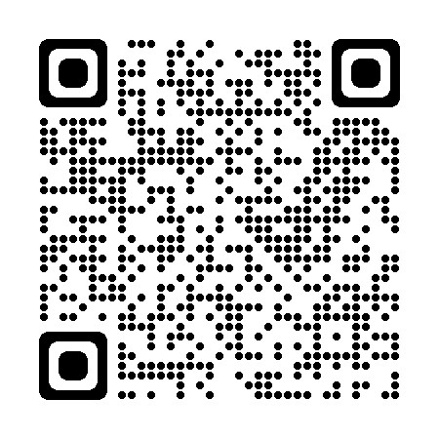
How to access the service
Clients can self-refer via the Single Point of Access (SPOA)
By Telephone on 01204 483101
Online via https://www.iaptportal.co.uk/bolt.html
We also accept professional referrals for talking therapies from General Practitioners and other health and social care professionals via the https://www.gmmh.nhs.uk/referral-services/.
Please ensure that you have the client’s consent to make the referral.

