Slide 1
Town Centre East Active Travel Activation Project Neil Hart – Active Lives Team

Slide 2
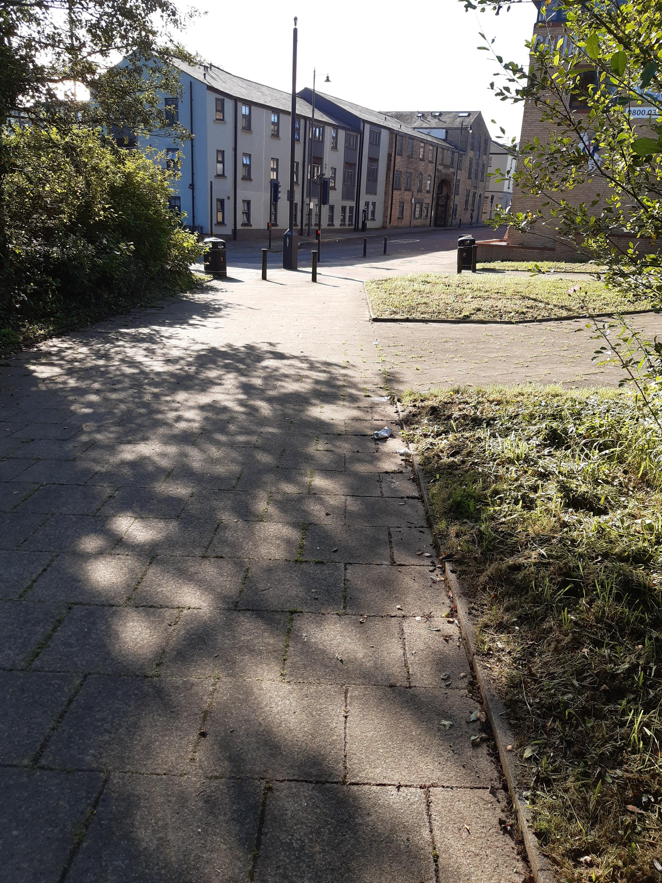
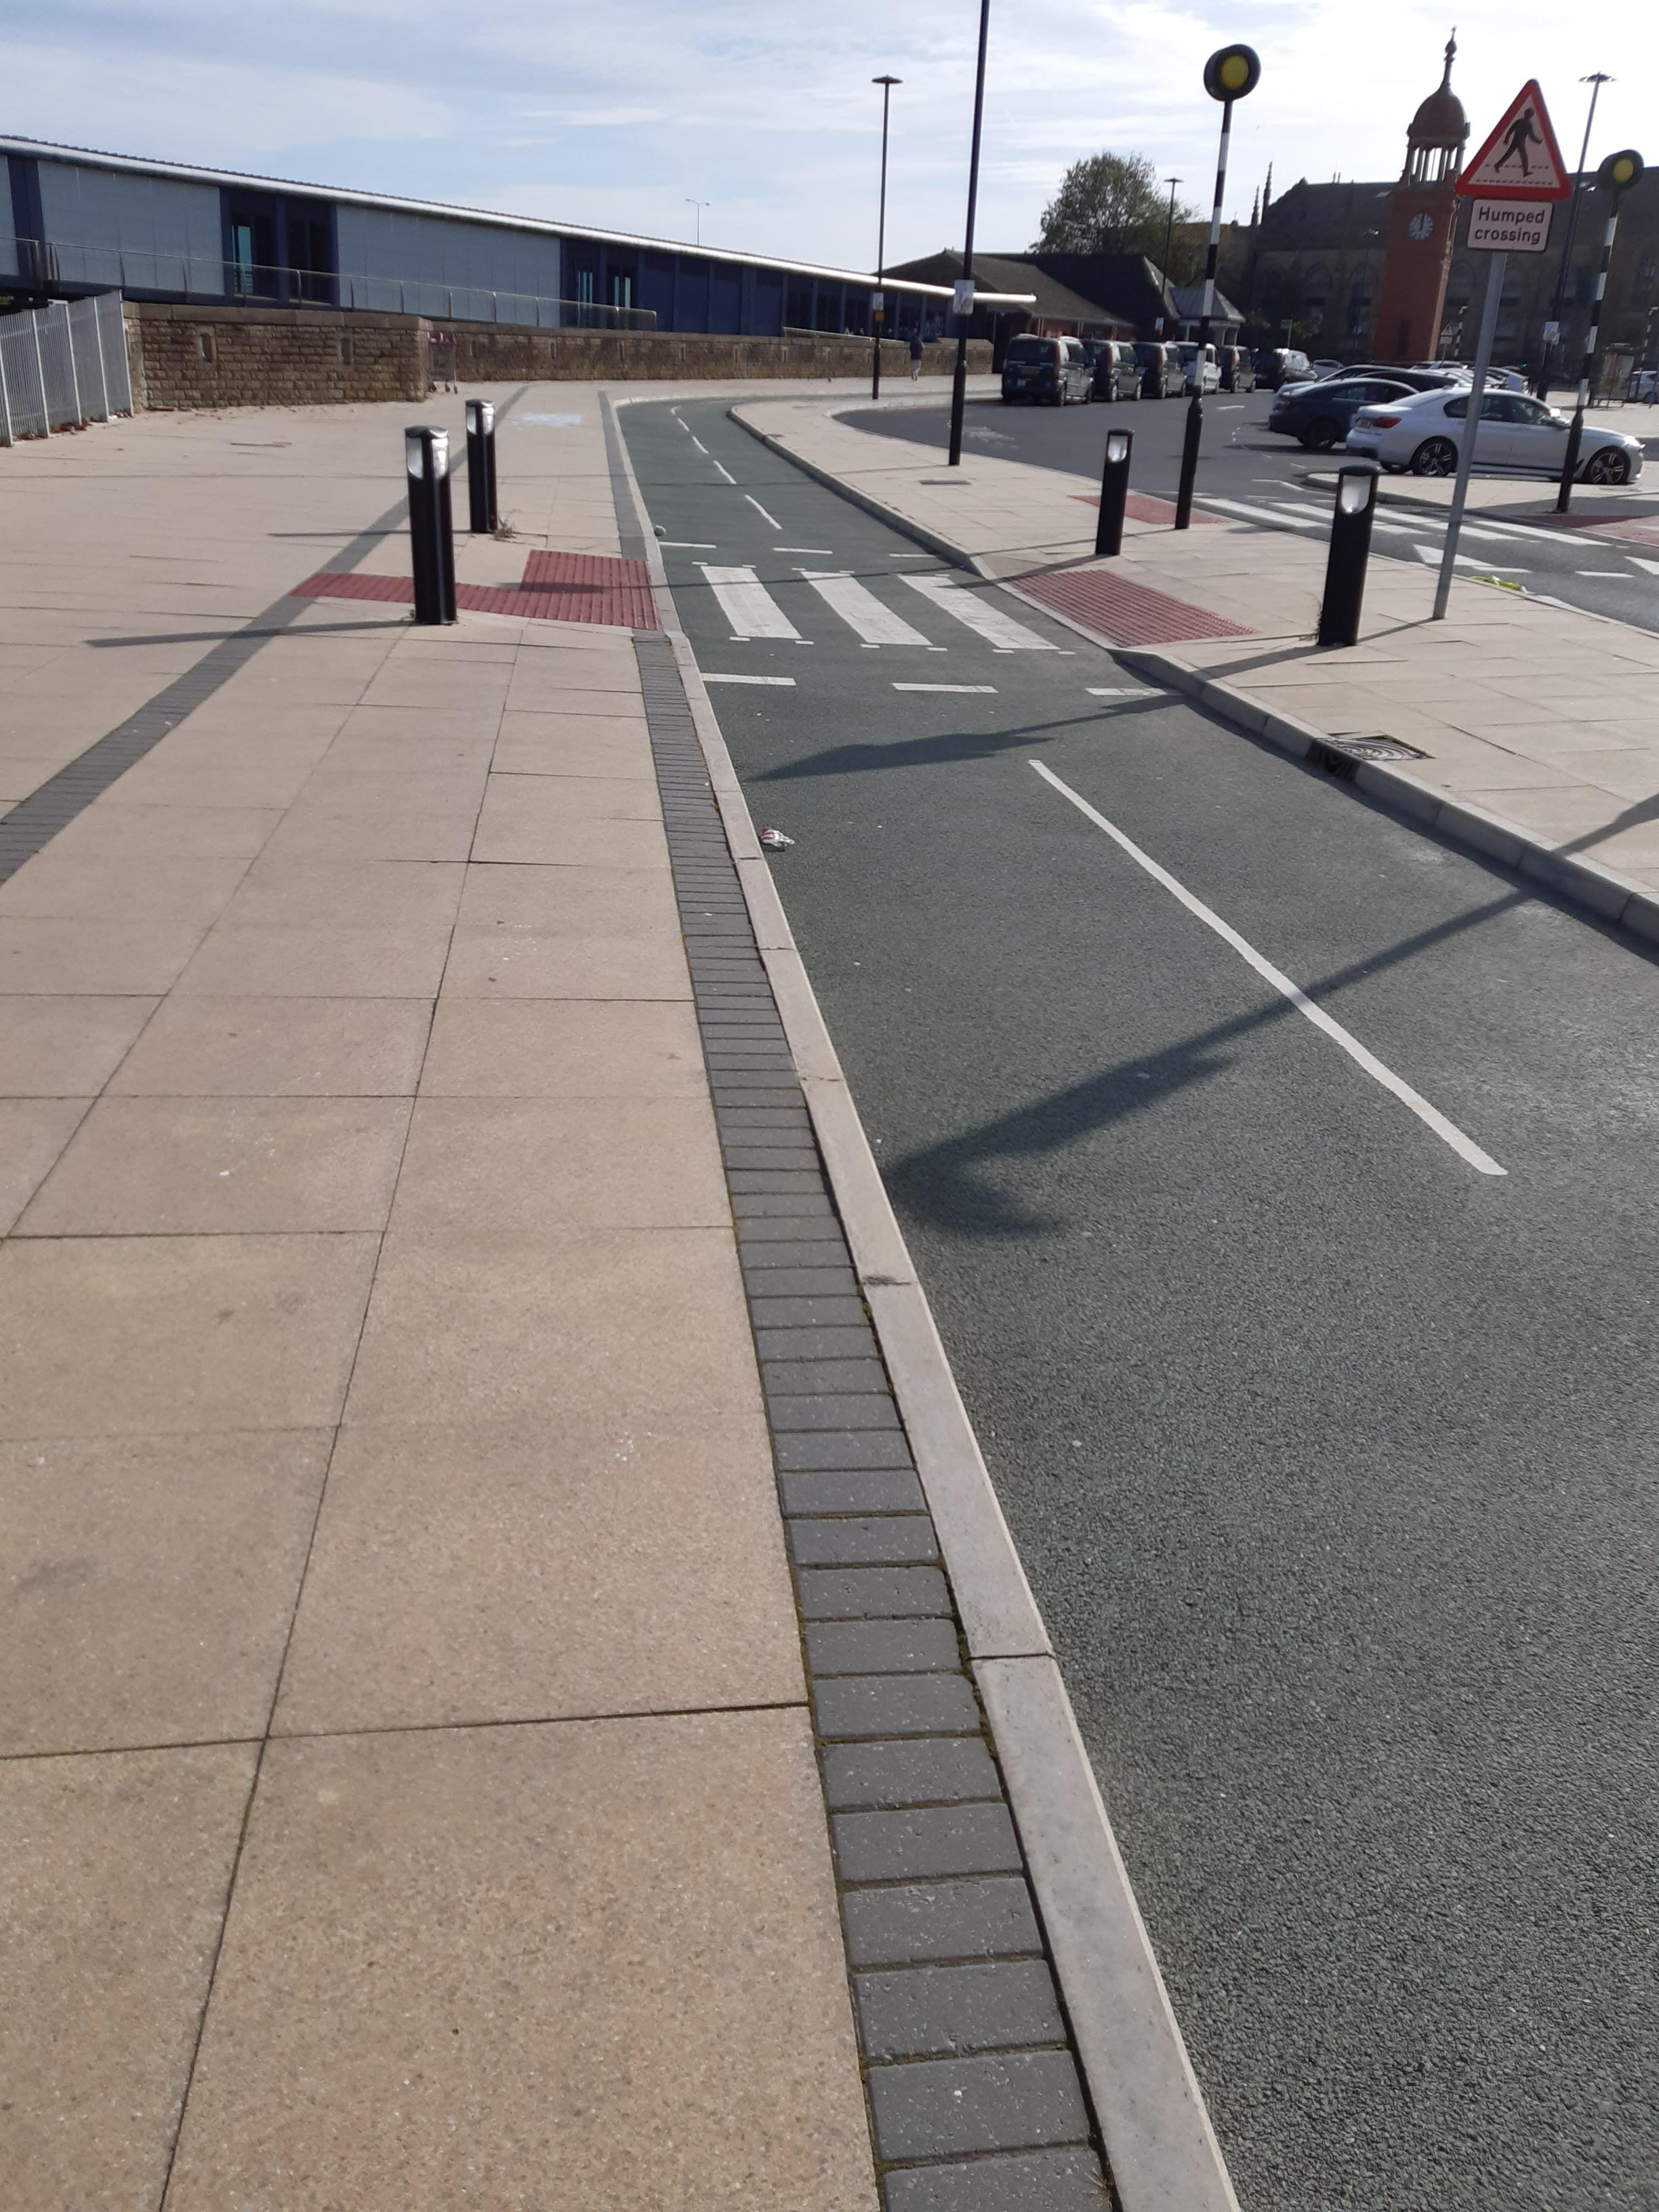
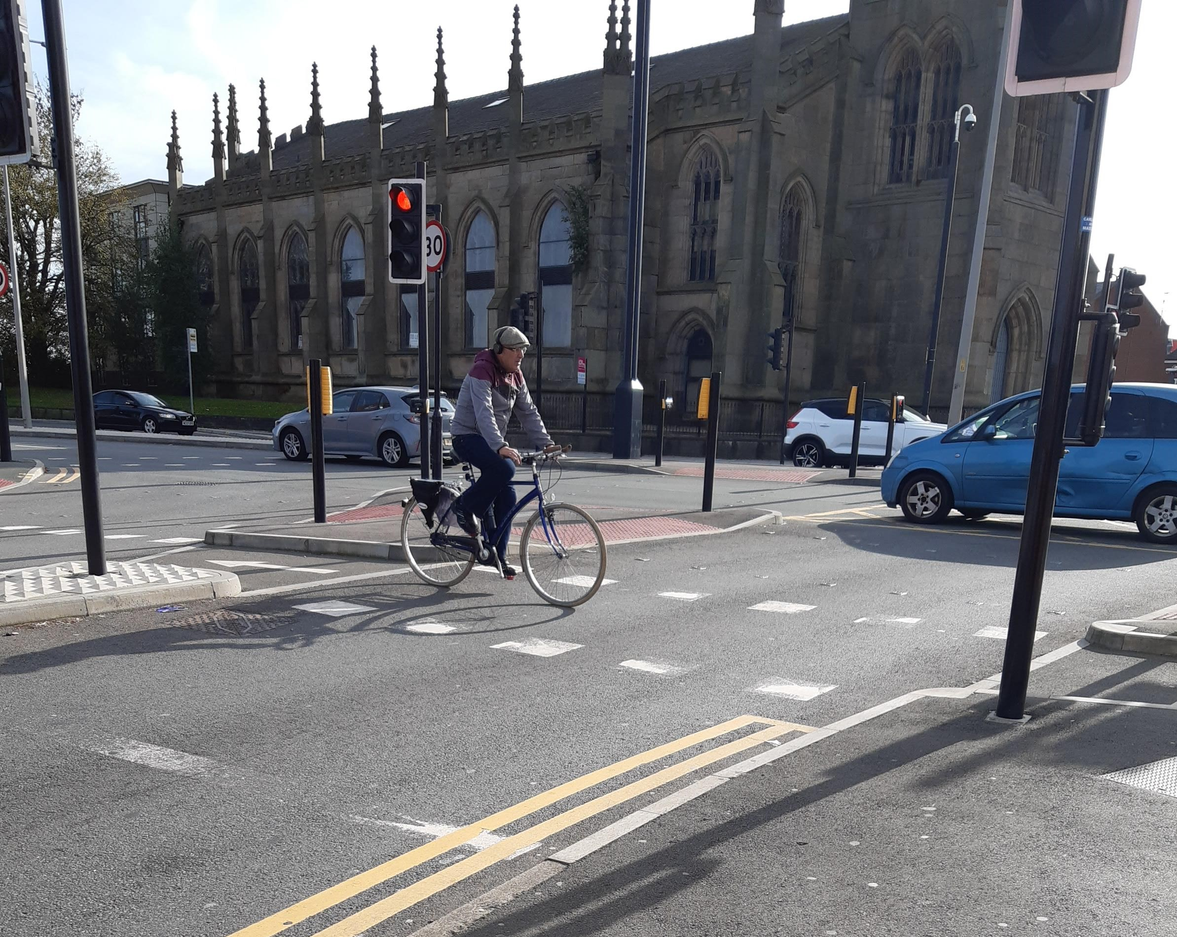
Current infrastructure

Slide 3
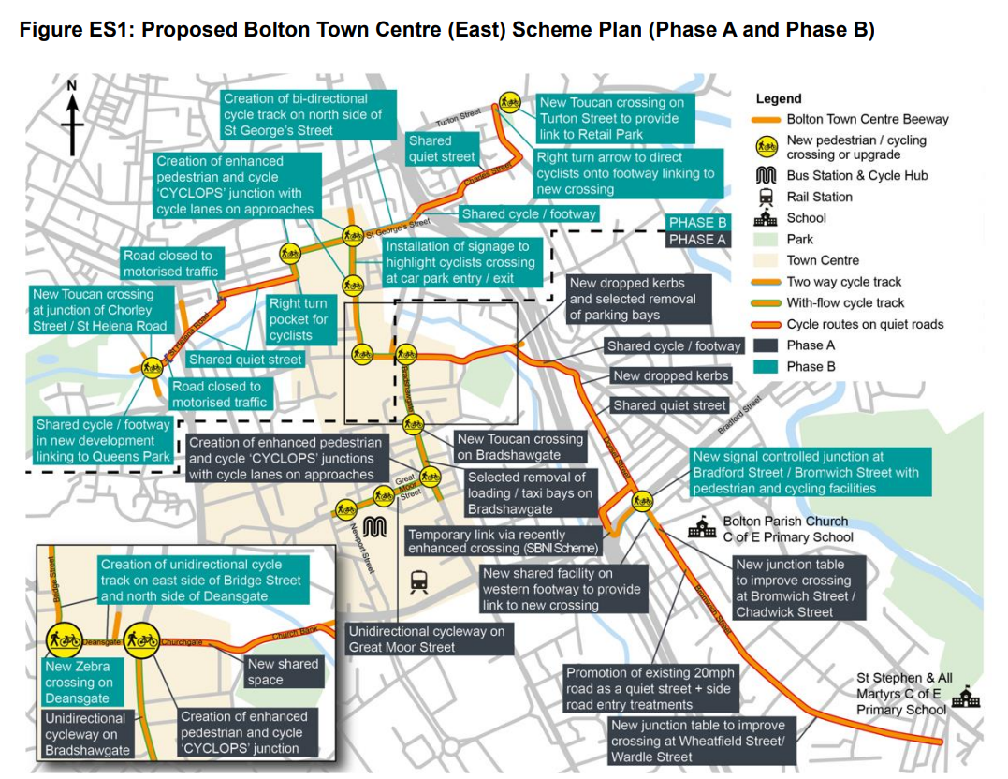

Slide 4
Increase the number of people choosing active travel for travel into and through Bolton Town Centre. Increase active travel modes as a proportion of the Bolton Town Centre area. Increase the amount of high-quality active travel infrastructure / public realm within the town centre. Enhance accessibility to the Town Centre. Improve actual and perceived safety and security of cyclists and pedestrians in the scheme area
Aims / objectives of the project

Slide 5
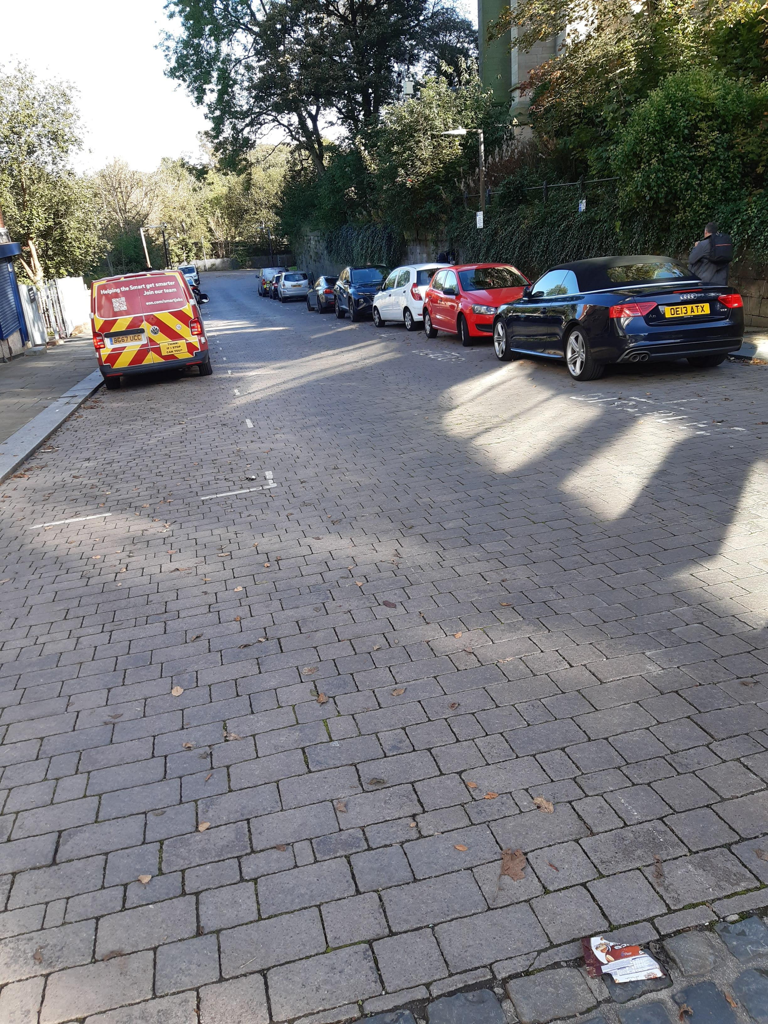
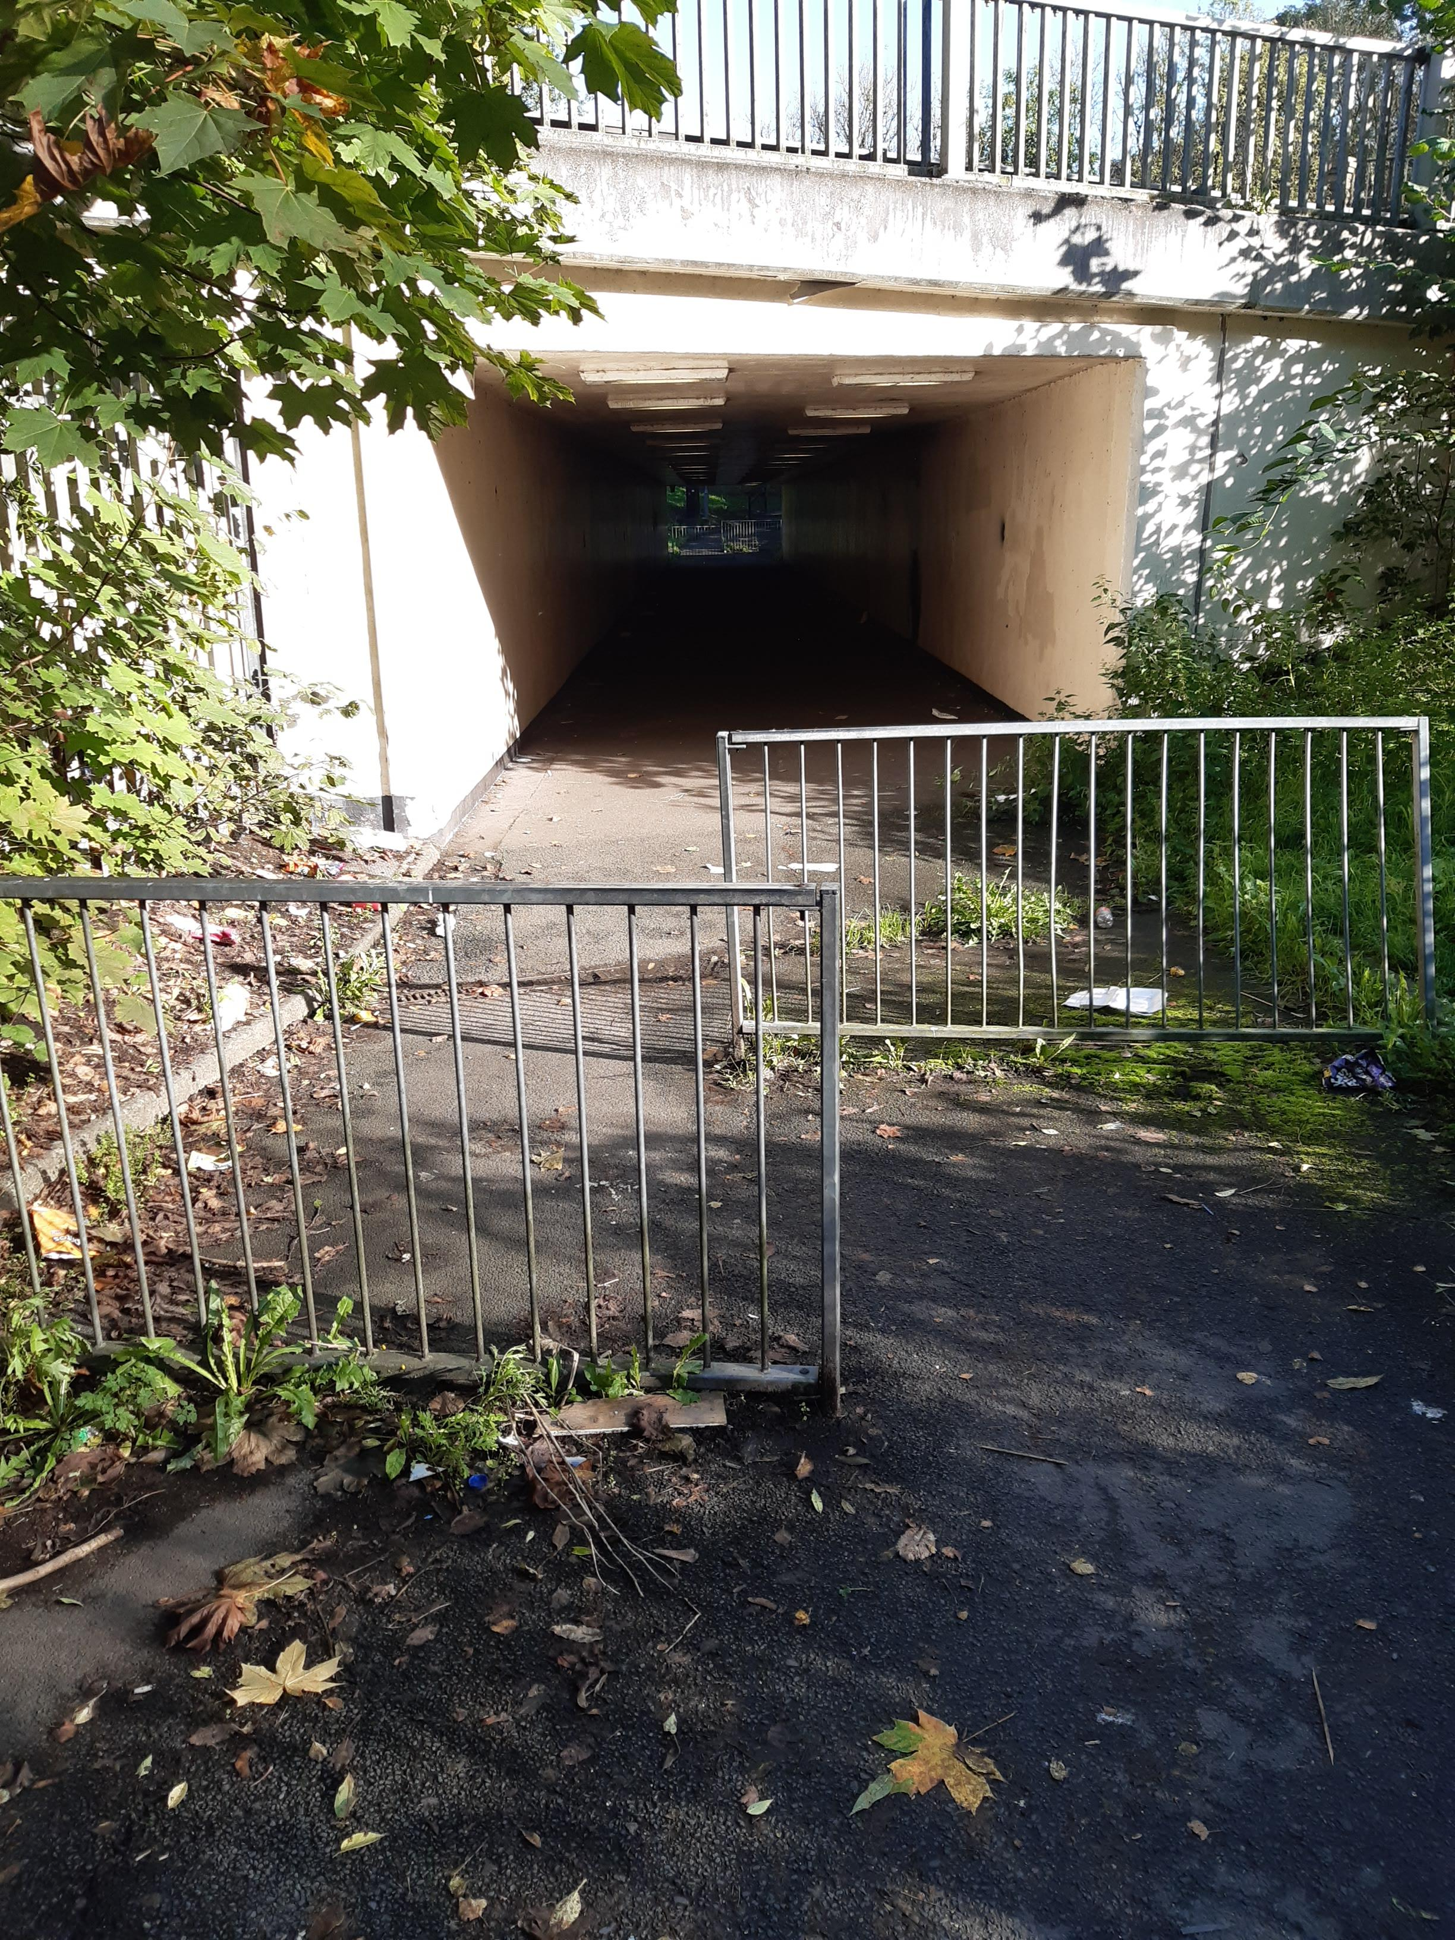
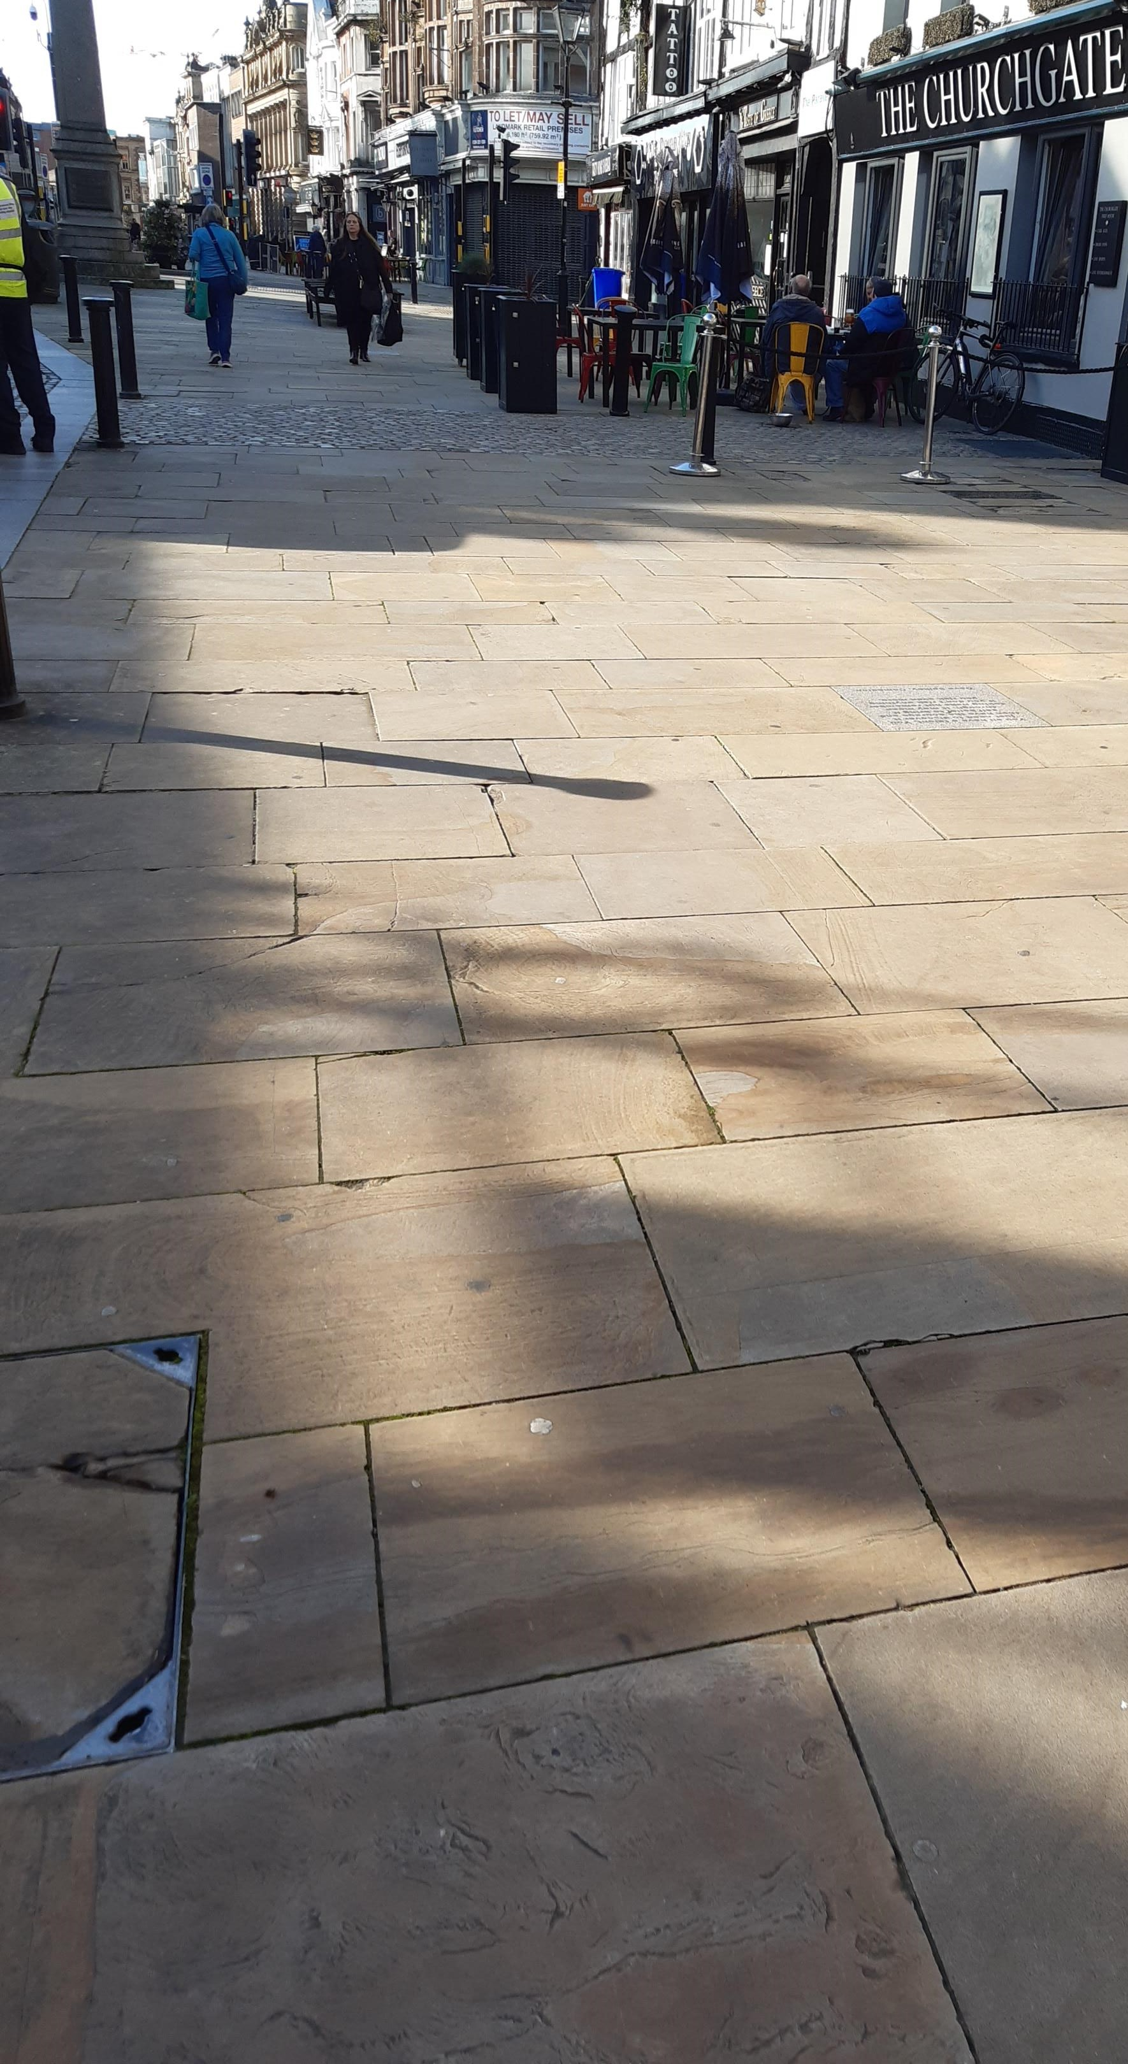
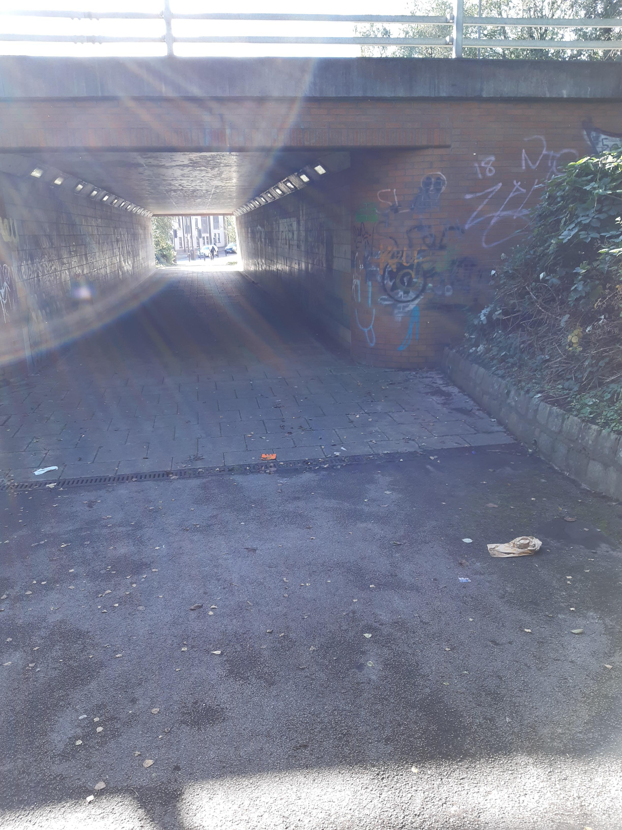
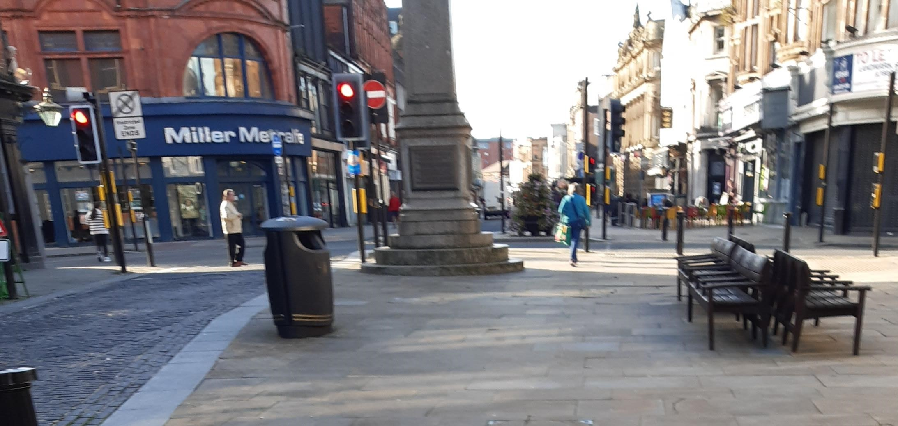
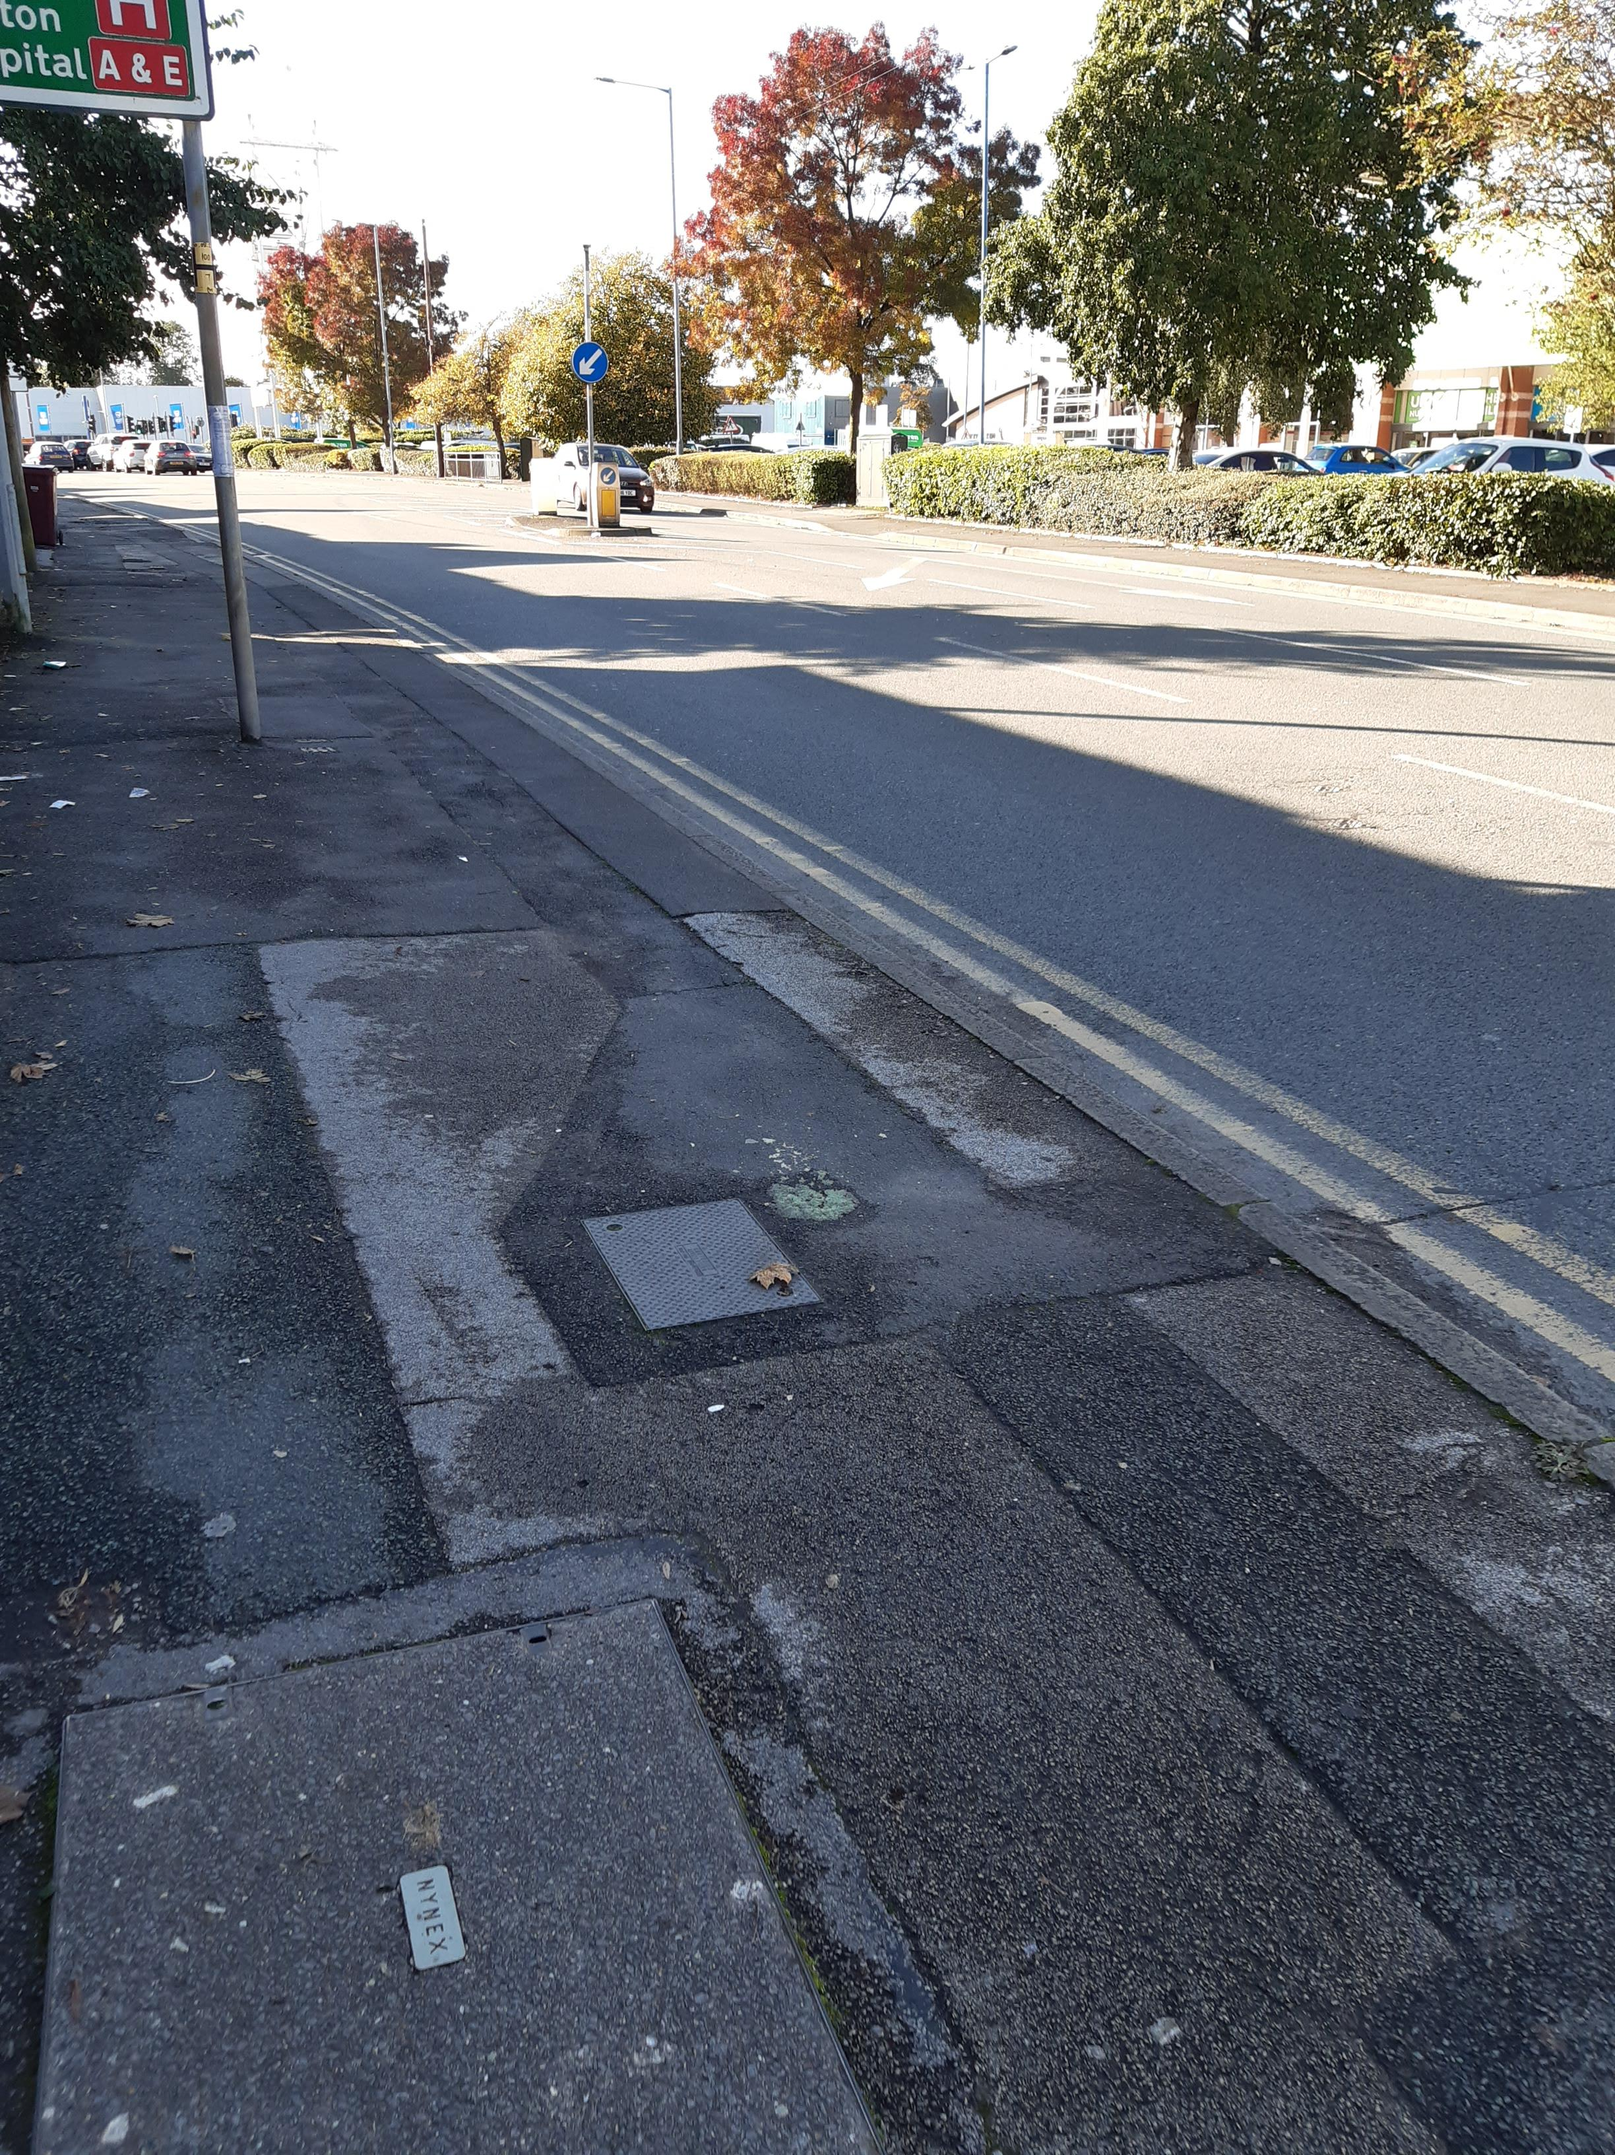
Areas to be changed

Slide 6
Action plan
Before installation | During installation | Once installed
Engagement with stakeholders | Continue relationships with stakeholders | Monitor usage
Create relationships / Steering group | Mitigation of disruption | Promotion / events
Information & Education around usage using different platforms | Promote benefits to users | Encourage usage
Training opportunities | Training opportunities | Training opportunities

Slide 7
Insight Collected from
BLGC
Police / PCSO’s
38 Businesses visited
University of Bolton
Primary Schools (Both staff & families)
Community Groups
Churches
3x Bike Libraries
Council officers / elected members
Bolton interchange
Wheels for All
Bolton CVS
Bolton Deaf society

Slide 8
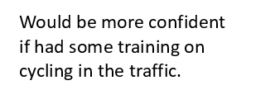
Insight given
Don’t own a bike
Would like to do it, but don’t have time
I do it already, wish my workplace had better
changing facilities
We have a salary sacrifice scheme at work for bikes but it’s not well used
It’s not safe
I can’t send my kids over that road, it’s too dangerous
Too many hills in Bolton
Not from Bolton, I have to come in my car for convenience / time

Slide 9
Future actions
Recruit members for steering group
Meet as a group
Create education materials as directed by group
Deliver family information sessions
Create a training programme around active travel modes
Development of activations within the community

