Slide 1








www.boltondes.org.uk
Community Digital Inclusion
Christopher Holden
Bolton
Digital
Employment
Skills

Slide 2


Project Overview
The Community Digital Inclusion Project is a UK Shared Prosperity Fund project that aims to promote digital inclusion across Bolton, as a part of the wider Digital Inclusion Agenda in Greater Manchester.
By establishing and growing partnerships with external organisations, community groups, charities, and commercial businesses, this project will create a network of digital support for the local community through a series of digital drop-in sessions; access to data via free sim cards, and the development and utilisation of a "digital lending library" of devices.
As a part of the wider Digital, Employment and Skills Team within Bolton Library and Museum Services, it aims to help develop a co-ordinated digital skills delivery across the town, to best support residents in need.

Slide 3



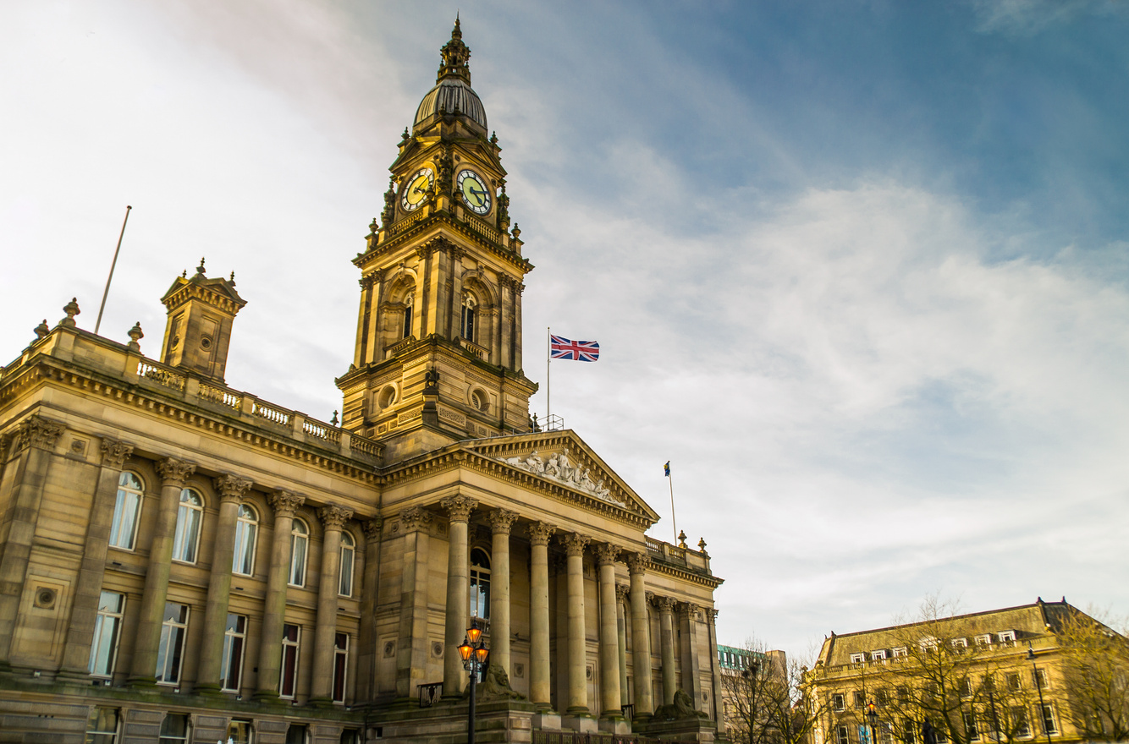

Core Goals
1.
Engage 10 venues across the Bolton boroughs to accommodate publicly accessible, digital drop-ins.
2.
Support 20 community organisations, volunteer groups or charities to develop, improve and deliver their digital offer.
3.
Help 800 residents of Bolton to access key digital skills, technology and connectivity.

Slide 4
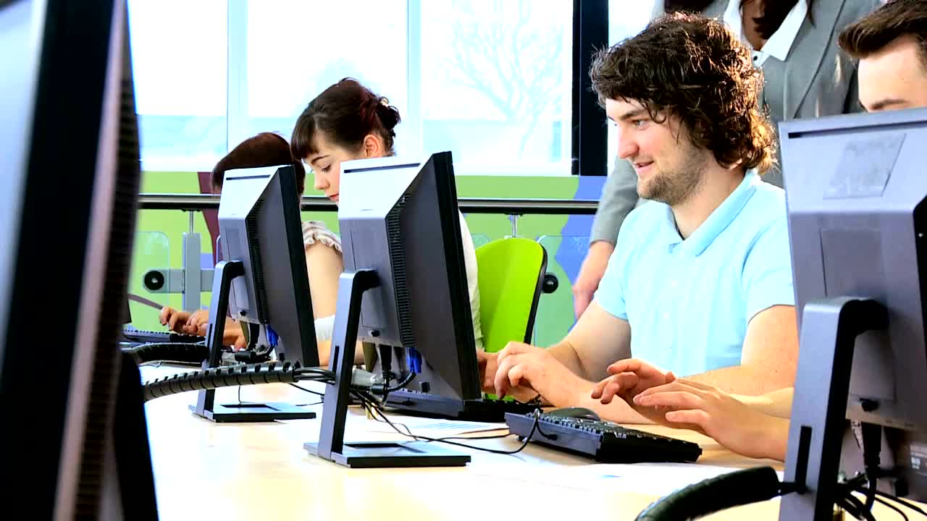

Community Focused, Developed and Delivered
  Emphasis on community organisations leading the initiative.
  Tailored support for each community's unique needs.
  Working towards Essential Digital Skills for all.
  Sustainable and locally-driven.
  Volunteer delivery.
  Publicly accessible.
  Supported training and assistance.

Slide 5

Key Digital Skills
Training will be provided to all digital volunteers through the Bolton DES Team and partner organisations, to enable anyone to deliver essential digital skills support to residents in the town.
All you need is the passion to help!
Essential skills include:
  Basic Device Navigation
  Accessing the NHS App
  General Productivity Applications (Word, Excel etc.)
  Online Job Searching
  Email Account Setup
  Digital Security & Safety
  Browsing the Internet
  Navigating Social Media
  Troubleshooting Common Issues

Slide 6









Partnership & co-operation
A key part of the project will be working in collaboration with local partners to deliver a coordinated network of skills provision. This will include the recruitment and training of dedicated, passionate volunteers to deliver digital sessions in a range of locations as well as venues committing to be part of the Bolton Digital Inclusion Activity Network to .
Using the informal digital drop-ins, tailored one to one support via the DES Team and SWY, and formal learning with Bolton College, this project aims to create clear pathways for residents to engage with digital skills in a setting and level that suits them.

Slide 7


Funding Opportunity
As a part of the project delivery, grant funding has been made available, determined via a needs assessment on a case-by-case basis, to facilitate the set-up, provision and logistics of the digital provision. Organisations wishing to apply for funding, will need to demonstrate their commitment to a set of agreed standards*:
  Commitment to Digital Inclusion
  Community Impact and Value
  Organisational Capacity
  Engagement with Target Demographics
  Collaboration Potential
  Flexible Session Formats
  Volunteer Recruitment and Training
  Sustainability Plan
  Financial Accountability
  Device Accessibility and Connectivity Provision
  Needs Assessment and Planning
  Measurable Outcomes
*Final criteria for grant funding to be agreed in advance with GMCA, UKSPF, Bolton Council and Bolton Digital Inclusion Activity Network

Slide 8


References and further information
Greater Manchester Digital Inclusion Agenda
UK Shared Prosperity Fund
Good Things Foundation - National Databank
Government Essential Digital Skills Framework
Bolton Digital, Employment and Skills Team
Digital Exclusion Risk Index (DERI) - GMCA
Bolton
Digital
Employment
Skills

Slide 9

Any Questions?
Chris Holden
christopher.holden@bolton.gov.uk
01204 332171
07385 012160
Bolton
Digital
Employment
Skills

