Slide 1

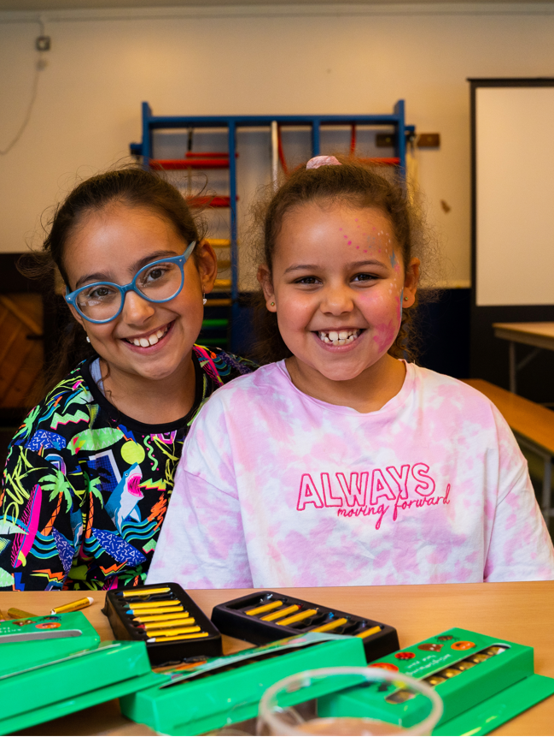
IN KIND DIRECT
We believe everyone deserves access to life’s essentials and that no usable product should go to waste.
powered by kind

Slide 2
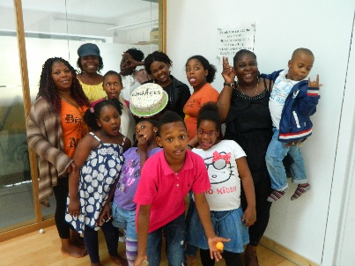
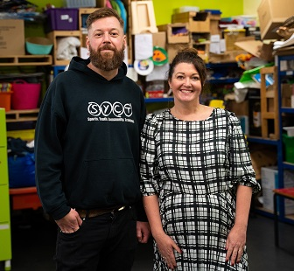
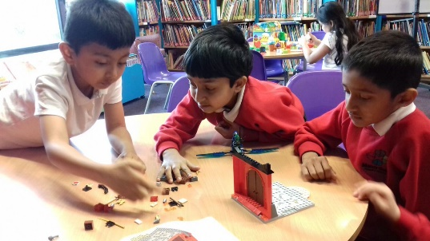
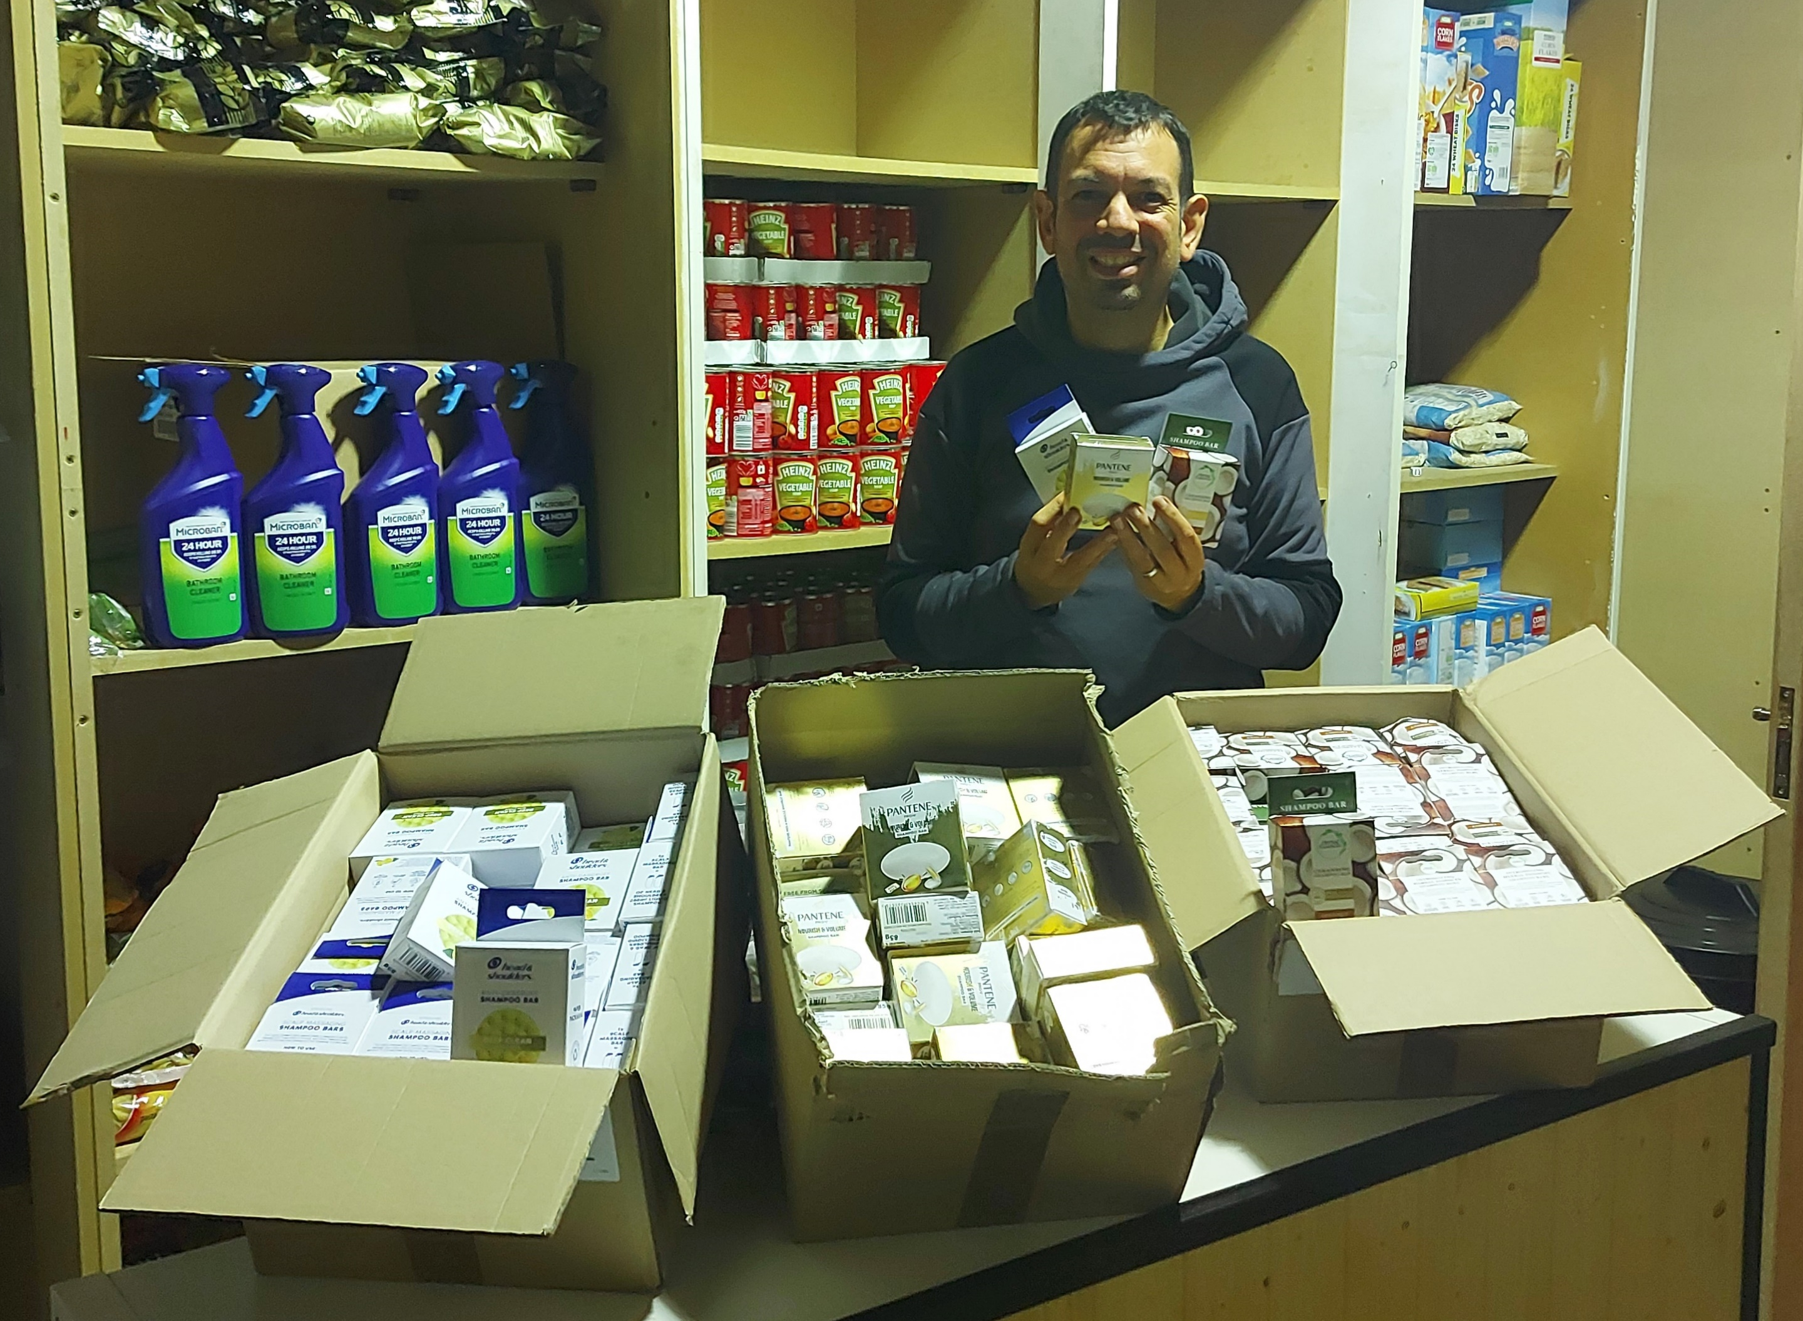
WE HELP c365,000 PEOPLE EACH WEEK
Community Groups
Registered charities, CICs, CIOs
Schools, scouts, guides, youth groups
Food projects, faith centres

Slide 3
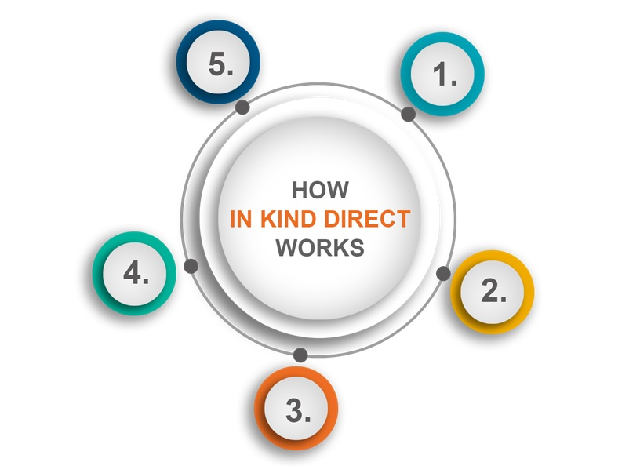
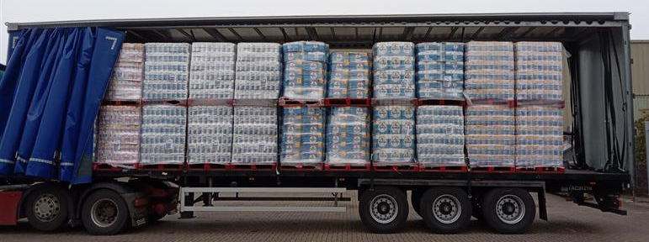
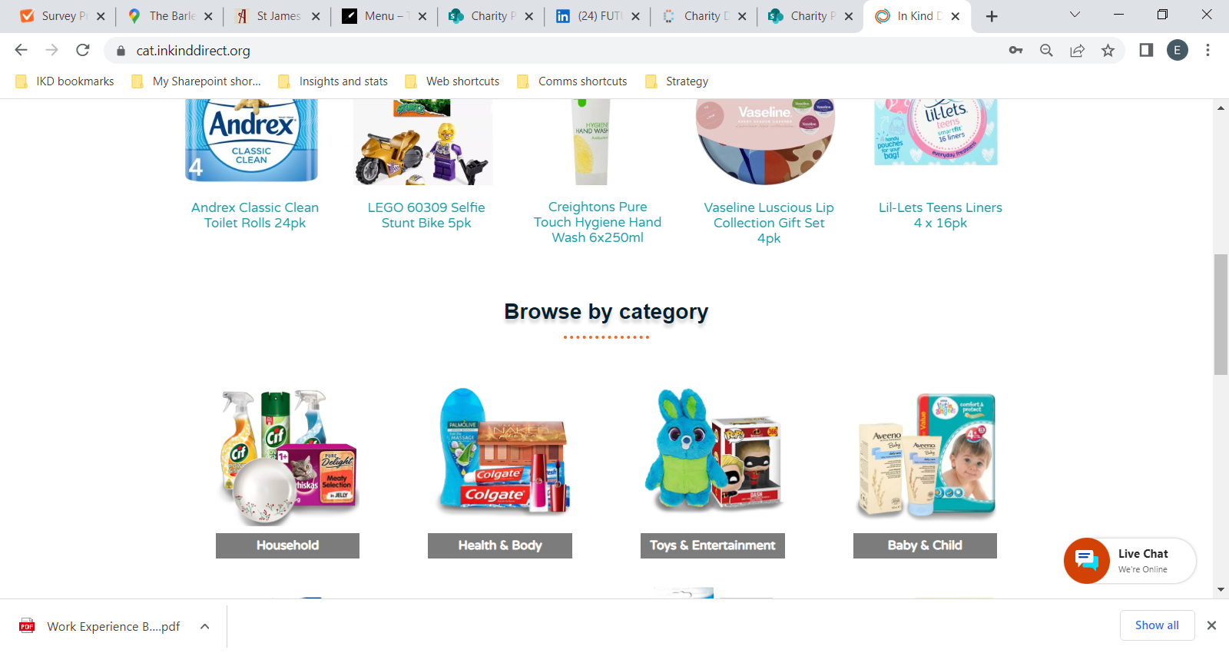

Creating impact
Products are donated
We feedback on the human impact the products have made to people’s lives. These inspiring stories are shared with funders, donating companies and our network.
Companies donate products in bulk such as personal hygiene items, household cleaning, toys, clothing, baby essentials, stationery, and technology.
Distribution
Products are received
We distribute the orders to charitable organisations who use the products to help run their services or to give away to people they support.
Once donations are received, we sort and store in our warehouse ready to be uploaded online
Products go online
Register for free:
inkinddirect.org/register
The products are made available to order via our secure online catalogue, only accessible to our network of registered charitable organisations

Slide 4
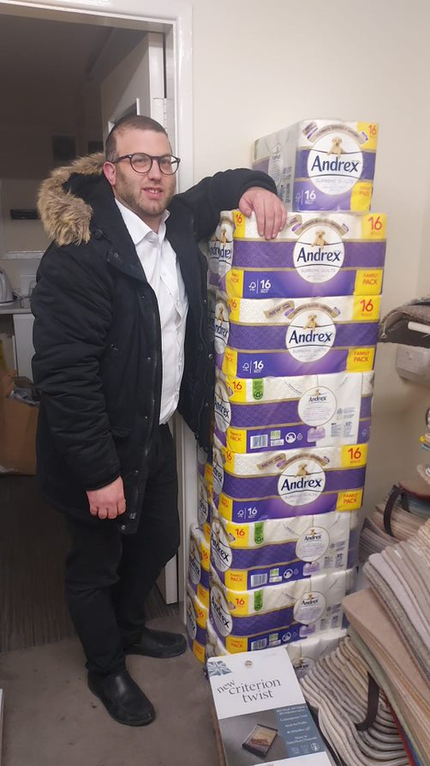
“In today’s unprecedented and turbulent times where families are literally struggling to pay for even the basic essentials, these type of donations go a long way to ease the burden and taking the pressure off day to day life. The positive effect cannot be underestimated.”
Filey Foundation, Greater Manchester

Slide 5
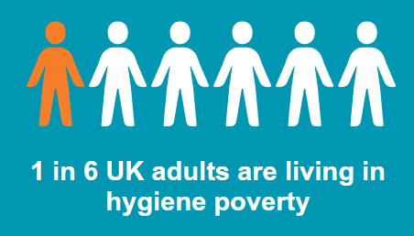
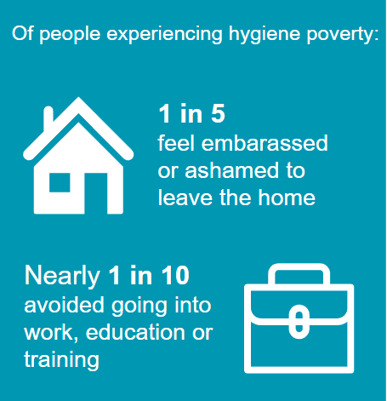
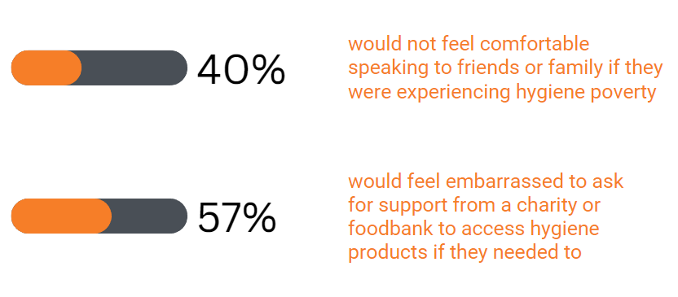
NOT A CHOICE
Our campaign aims to raise awareness of hygiene poverty
Born out of 2022 In Kind Direct ‘Human Right to Hygiene’ report
Raise awareness of hygiene poverty in the UK and spark conversations to reduce stigma around hygiene poverty

Slide 6
“An older lady was thrilled to receive conditioner for her hair and was telling everyone to stroke her hair for how soft it felt because she hadn’t used it in months. Her smile and boost to self-esteem was infectious and truly heartwarming.”
Social Enterprise, Doncaster
“We have a family with teenage girls who were suffering from period poverty. We provide little packs, some in discreet packaging for school bags, and this has improved their school attendance, confidence, and reduced isolation.”
Community Support Organisation, Stoke-on-Trent

Slide 7
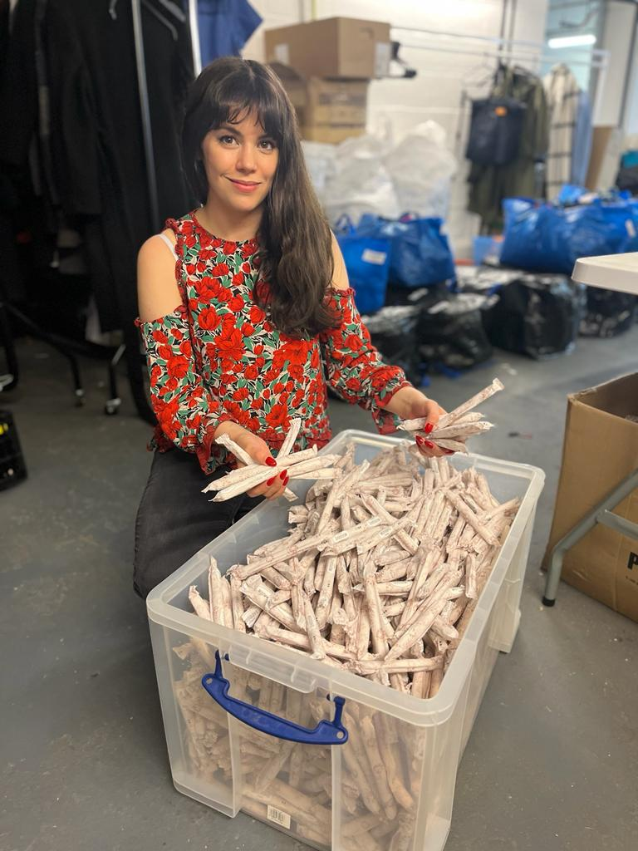
ANY QUESTIONS?
Victoria Zamperoni
Policy & Research Manager
Email: victoria.zamperoni@inkinddirect.org
To join the In Kind Direct network:
inkinddirect.org/register
Notes:
Get in touch about your surplus
Support our second phase of not a choice launching September
Consider a charitable element to a new product launch or promotion, or even regular donations of essential products

