Slide 1
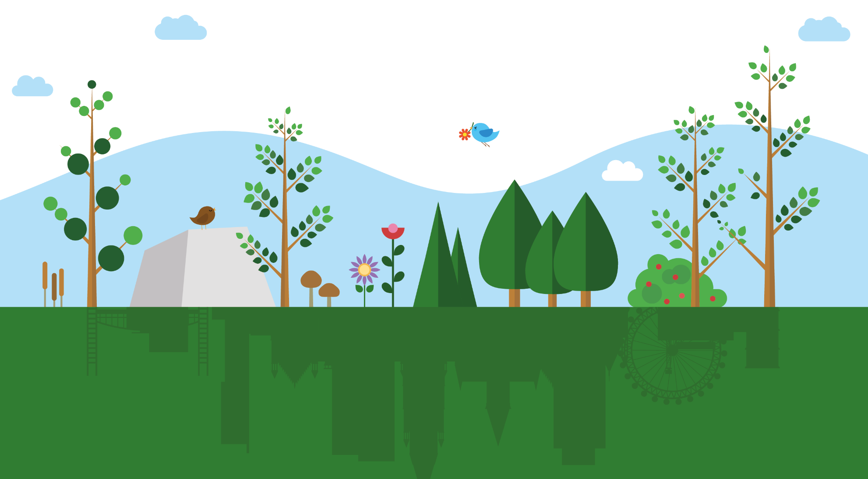
GMEF
FUNDING A GREENER GREATER MANCHESTER
Greater Manchester Green Spaces Fund
@gmenvfund
www.gmenvfund.org
gmenvfund@lancswt.org.uk

Slide 2
Tackling the climate and biodiversity emergencies in Greater Manchester
Notes:
Aimee

Slide 3
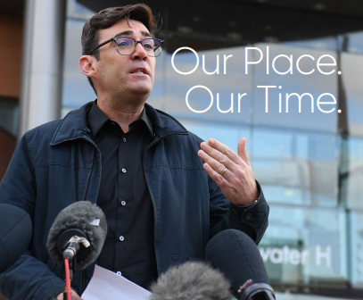
The Mayor’s manifesto commitments
“We will improve our green spaces and open them up to more people.
In support of this…we will create a new ‘Green Spaces Fund’ to give small grants to communities to clean up and improve pocket parks and local green spaces or create new ones where they are needed.
[We will] increase the amount and quality of accessible nature-rich green space, particularly for our poorest residents.”
Notes:
Aimee

Slide 4
Translating this into the aims of the Green Spaces Fund
Aim 1 – Benefit communities in greatest need of quality green space 55%
Target communities where there is poor access to quality green spaces
Benefit communities experiencing inequalities
Aim 2 – Tackling our climate and biodiversity emergency 15%
Enhance biodiversity in Greater Manchester’s green spaces and create new green spaces
Adapt the city region to climate change
Aim 3 – Encourage and empower communities to get 15% involved in nature
Connect communities with nature
Greater Manchester Environment Fund
Realising Greater Manchester’s Ambition for Improving the Natural Environment
Notes:
Aimee
Mention scoring weighting aim 1 55% aim 2 15% aim 3 %

Slide 5
Criteria
Applications will be prioritised from projects which will benefit communities experiencing inequalities (for example those in areas with high levels of deprivation) and lacking access to quality green space (for example in areas without a public park nearby or lacking greenery).
We will prioritise project proposals in areas of high deprivation, as indicated by the index of multiple deprivation. Applications are open to all but we want to target the fund toward communities in greatest need, with poor access to quality green and blue space, or on green space adjacent to these communities.
You can use the IMD mapping tool and the Natural England Green Infrastructure map to see if your project location meets the criteria
IMD: https://imd-bypostcode.opendatacommunities.org/imd/2019
Access to Greenspace: https://designatedsites.naturalengland.org.uk/GreenInfrastructure/Map.aspx

Slide 6
Eligibility
Organisations
Applications are open to :
Community Groups, associated or unincorporated community associations
Registered charities, including Charitable Incorporated Organisations (CIOs)
Social Enterprises or Community Benefit Societies
Community Interest Companies (CICs)
Tenant and or Resident Associations
Schools and academy trusts
Accountable bodies - The following organisations can act as accountable bodies to support an application from a community group or organisation listed above:
Registered housing providers
Local authorities
Local parish councils
By acting as an accountable body, these organisations will take on the legal responsibility for the project and would be financially accountable for any grant that is distributed to their partner organisation.
02
Notes:
Emma
Focus on accountable bodies

Slide 7
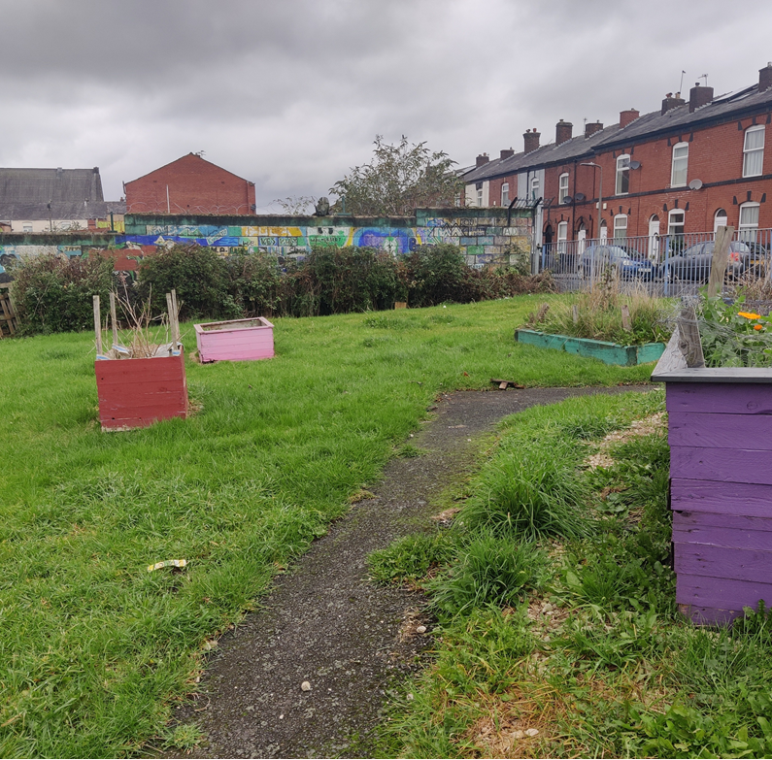
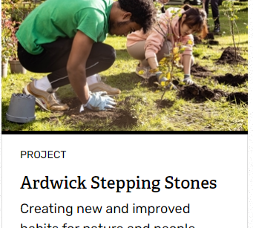
Round 1 & Round 2 Successful Groups
Supporting Sisters Peace Garden
The Roost at Bright Meadows
Ardwick Climate Action
All projects available to see on website
Notes:
Emma
Round 1 £400k for 21 groups
Round 2 just under £800k for 31 groups

Slide 8
Timeline
All projects will need completing within 12 months
First Round
Late Sept 2022: Greater Manchester Environment Trust (GMEF) Board approval
Oct 2022: Award Letters and initial payments made for first round awardees
Second Round
Oct 2022: Second round opens: 31st of October
Jan 2023: Second round closes 27th of January
March 2023: GMEF Board approval
Third Round
27th March 2023: Third round opens applications for consideration
9th June 2023: Third round closes
TBC: GMEF Board approval
Fourth Round
Expected to open early September 2023
Where we are currently!
Notes:
Aimee

Slide 9
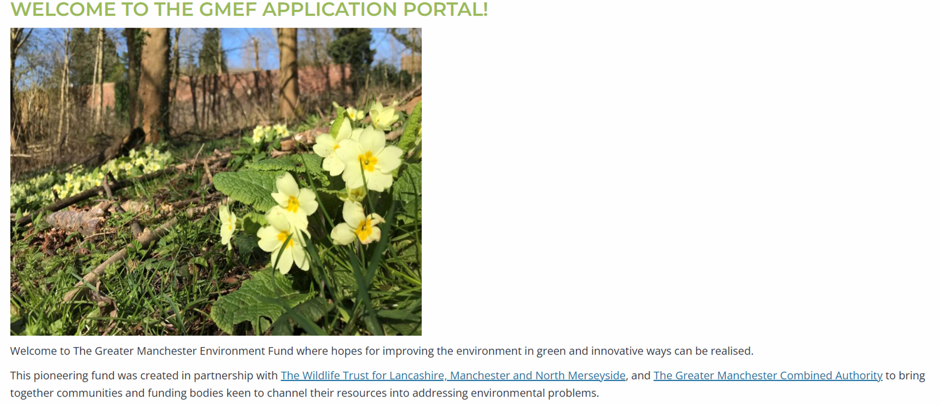
02
How to apply for funding
To apply for the fund, you must complete the application via the portal on the website. You will be asked a series of questions relating to your project ideas, location and sustainability.
https://gmenvfund.org/green-spaces-fund
You MUST submit your final application form via the portal on the website. There is also a guidance document, FAQ’s and templates of the additional documents you must add to your application such as the costing and monitoring template.
Application process
02
Notes:
Emma
Screenshot of portal

Slide 10
GSF Webinars available to catch up online
Introduction to the Green Spaces Fund
Meeting the essential criteria
The application process
Meeting Aim 1 of the fund - Benefit communities in greatest need of quality green space
Meeting Aim 2 of the fund - Tackle our climate and biodiversity emergency
Meeting Aim 3 of the fund - Encourage and empower communities to get involved with nature
02
Notes:
Aimee

Slide 11
03
Green Spaces Fund Advisors
Who are the advisors?
A critical friend to help you complete your application form
From refining ideas to sustainability of a successful project
Targeted engagement: working together with LAs and others, to ensure those who will benefit the most can access the fund
Specialisms from a rich partnership
Local Authority lead relationships
Shared ‘case’ management
Notes:
Aimee

Slide 12
Contact Details:
Areas Covered | Organisation | Specialism | Contact details
Bolton Bury | Lancashire Wildlife Trust | Nature Recovery and Wellbeing | Emma Smith: esmith@lancswt.org.uk
Stockport Tameside | City of Trees | Tree planting | Katie Jones, Agnes Allison katie@cityoftrees.org.uk ; agnes@cityoftrees.org.uk
Rochdale | Groundwork | Eco Streets | Lydia Marshall Lydia.marshall@groundwork.org.uk
Wigan | Groundwork | Eco Streets | Steven Hodges Stephen.Hodges@groundwork.org.uk
Manchester Trafford | Sow the City | Food Growing | Kieron McGlasson kieron@sowthecity.org
Oldham Salford | Royal Horticultural Society | Horticulture | Nina Agnew: ninaagnew@rhs.org.uk
02
Notes:
Aimee

Slide 13
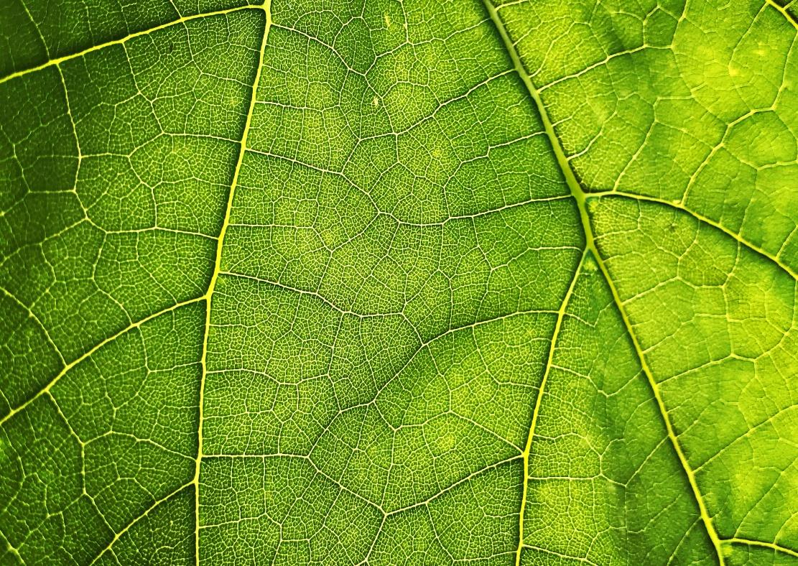
Thank You
Notes:
Introduce next group

