Slide 1
Managing risk and risk assessments
Elaine Butt
Safeguarding and Governance Senior Officer

Slide 2
What is a risk assessment?
A risk assessment is a methodical examination of a task, job or process that you carry out for the purpose of identifying the hazards, the risk of someone being harmed and deciding what further control measures you must take to reduce the risk to an acceptable level.
It is only effective if you act on it, follow through with any actions required and review regularly.
If you are an employer you are required by law to protect employees and others from harm.
Notes:
5 mins

Slide 3
Steps needed to manage risk
Identify the risk
Think about what you do and how you do it, what might cause harm?
For each example think about how this could affect employees, volunteers, members of the public and staff.
Think about vulnerable beneficiaries, volunteers or members of staff, they may have particular requirements and also about providing information in languages other than English.
Talk to employees, volunteers and beneficiaries – they may have ideas which could help.
Notes:
5 mins

Slide 4
Steps needed to manage risk
Assess the risks
decide how likely it is that someone could be harmed and how serious it could be.
What are you already doing to control this.
What further action do you need to take to reduce the risk.
Who needs to take the action.
When does it need to be done.
Notes:
5 mins

Slide 5
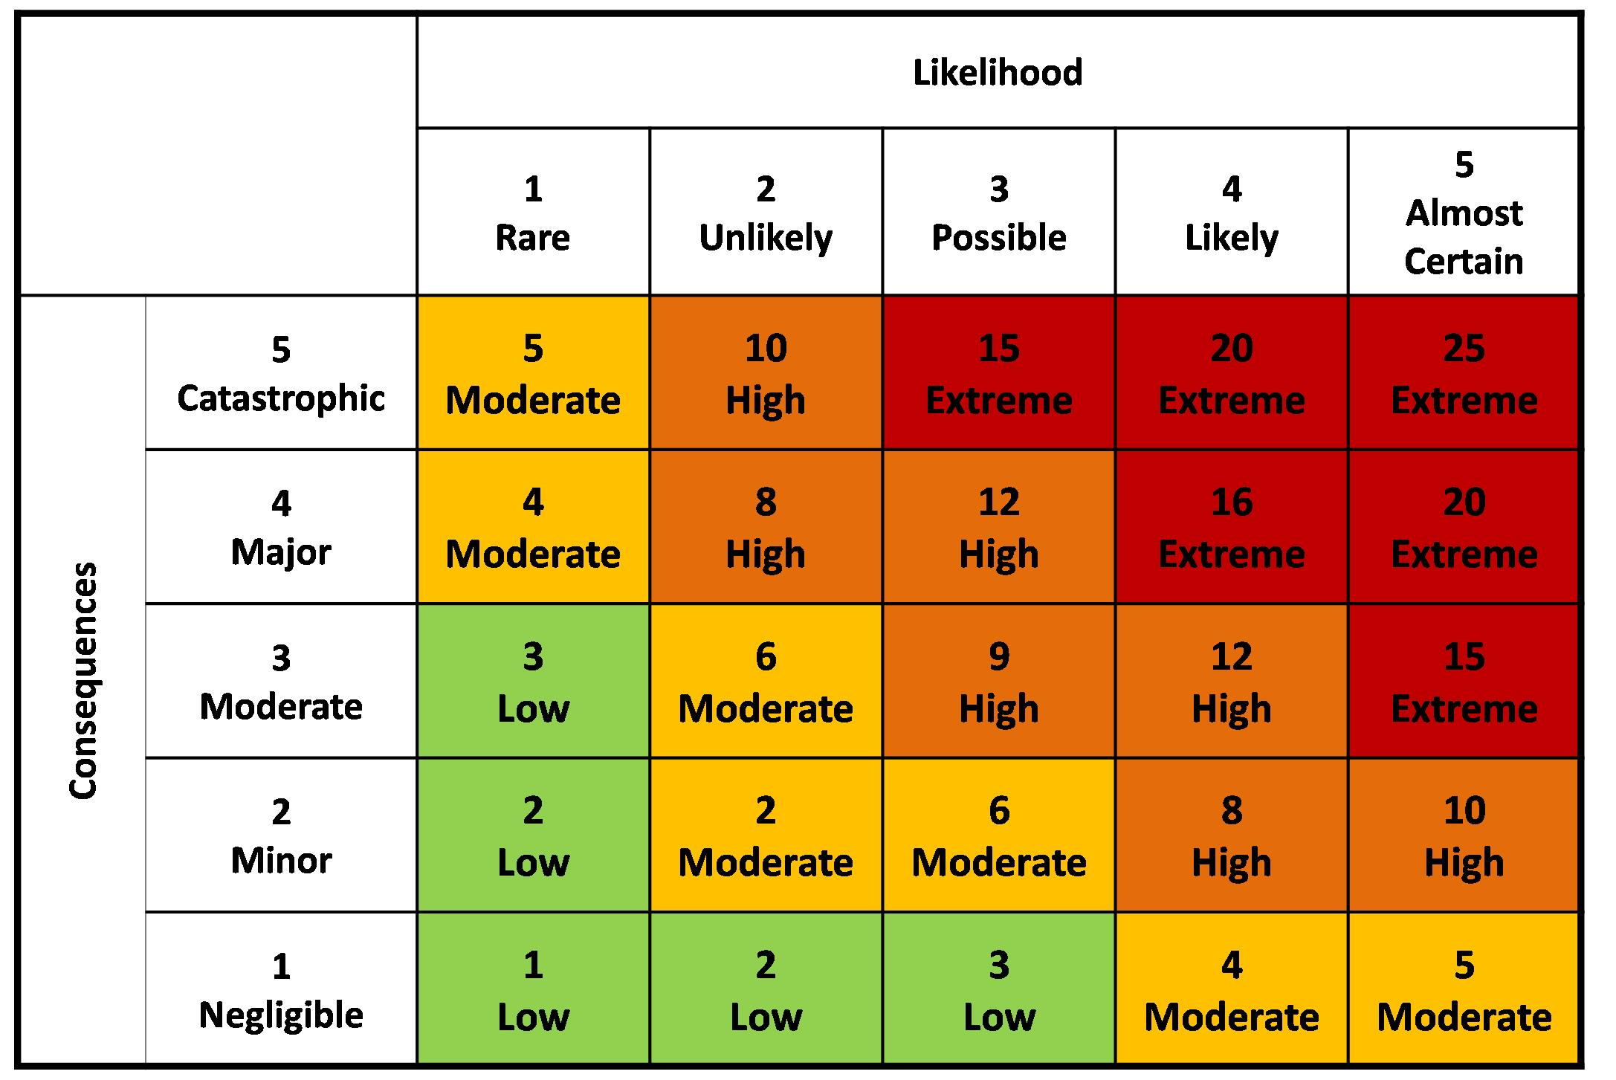
Risk matrix

Slide 6
Steps needed to manage risk
Control the risks
Look at what are you already doing and the controls you already have.
Hierarchy of control
Eliminate the risk – control the hazard at source
Substitution – replace a know hazard with something safer to reduce the risk
Engineering controls – can you use equipment to reduce risk
Administrative controls – change the way you do something
PPE - use to protect if no other option
Notes:
5 mins

Slide 7
Steps needed to manage risk
Record your findings
Use templates - widely available
Review your controls
Especially if there are changes such as new processes, new projects, new roles or if problems have been highlighted and in the current climate when new government guidance is issued.
Update risk assessments if changes made.
Notes:
5 mins

Slide 8
An example
Activity | Hazard | Pre control measure risk rating | Control measures | Persons responsible | Residual risk rating
Shopping by a volunteer for person self-isolating | Exposure to covid-19 | Catastrophic (5) and possible (3) = 15 Extreme | Follow most recent guidance on social distancing and hand washing whilst completing the shop and delivering the shopping. When delivering the shopping, leave the shopping at the front door, knock or ring the bell and step back 2m before door is opened. Do not enter the property. If possible get details of the list by phone and use contactless payment or volunteer shopping card. If list and cash to be collected these should be placed in an envelope, the householder should place them at the front door once opened and step back to allow the volunteer to pick them up | Volunteer (also ensure the person receiving the shopping is aware of process) | Catastrophic (5) and rare (1) = 5 Moderate

Slide 9
Useful information for the current situation
Health and Safety Executive
Risk assessment templates
Latest covid 19 guidance
Sample risk assessments
Government guidance
Gov.uk website
5 steps to working safely
Factsheet on CVS website
Notes:
5 mins

Slide 10
Further support
Contact Elaine Butt, Safeguarding and Governance Senior Officer: elaine@boltoncvs.org.uk
Call: 01204 546055

